Slide 1


September 8, 2026
7:00 PM Rimrock High School Library

Slide 2



Attitude of Gratitude

Slide 3
Dan Coleman: Quest CPAs PLLC
Audit Report
2025-2026 Audit

Slide 4
Elementary Enrollment
Grand View
K- 13
1- 9
2- 16
3- 17
4- 14
5- 14
PreK-10
Bruneau
K- 2
1- 1
2- 5
3- 1
4- 6
5- 6
<<< PreK- 4

Slide 5
Elementary Events
9/9-9/22 IRI Testing
9/10 Grandparents Day at BES
10/5-8 Fire safety week
10/9 All staff PD in Boise

Slide 6
Shoutouts
Karla - added food service
Claudia - added janitorial
Brea - now teaching kinder
Susan - now teaching 4 grades
Summer - now teaching upper elementary
Madie - now teaching PE district wide and coaching
Anna- teaching music district wide
Lois - now title I para and library
Cassie - added library/sped
AmeeLynn - lead para
Laura - now SpEd district wide

Slide 7
PreK data?
letter names/sound, digit name, 1:1, counting

Slide 8
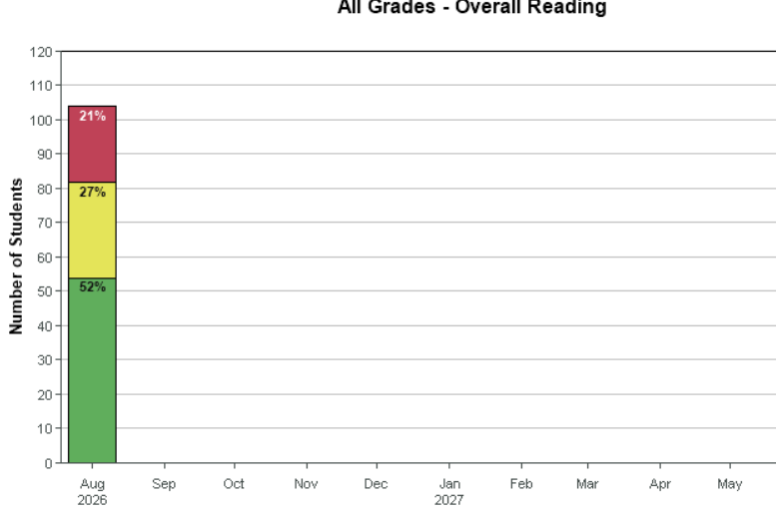
80%

Slide 9
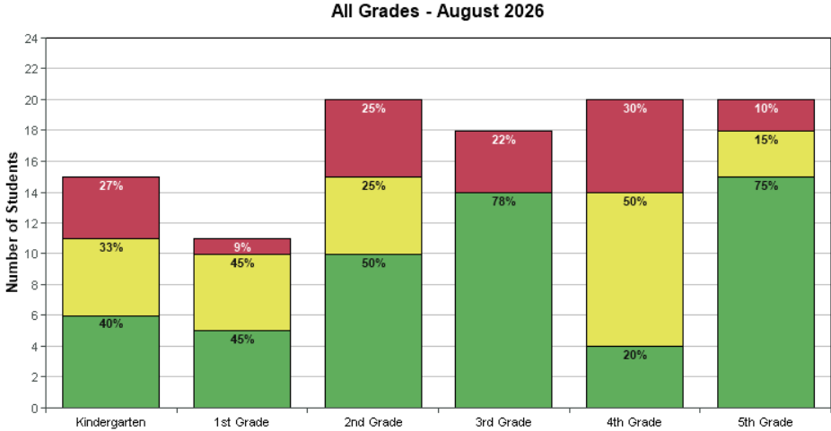

Slide 10
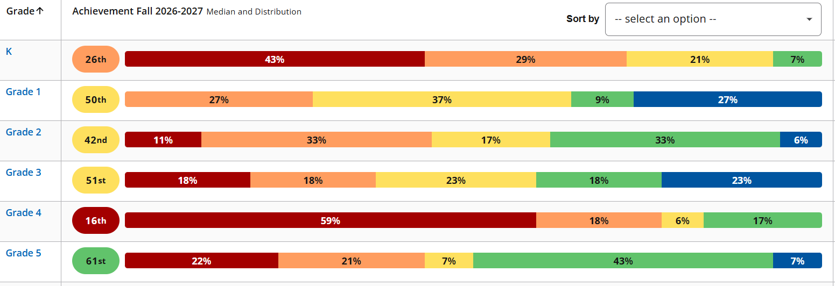
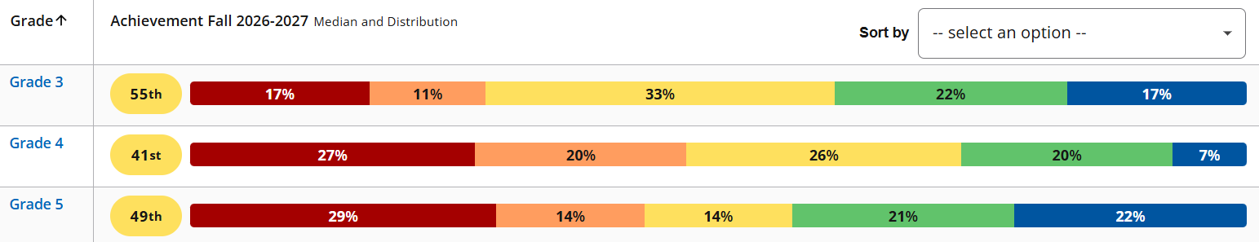
Reading Achievement
Language Achievement

Slide 11
Reading Growth
Language Growth

Slide 12
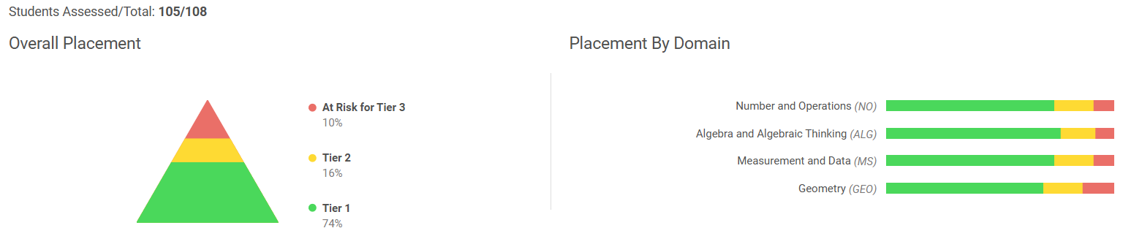

Slide 13
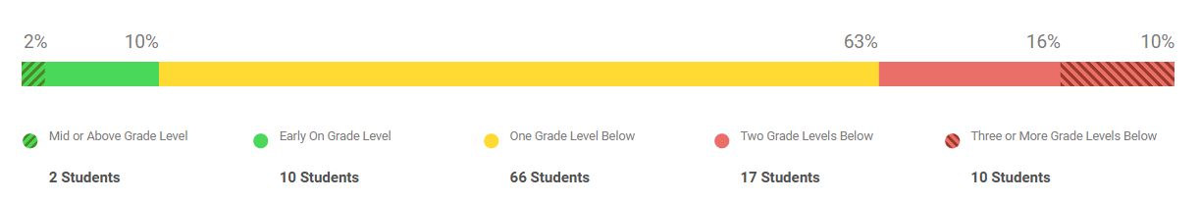
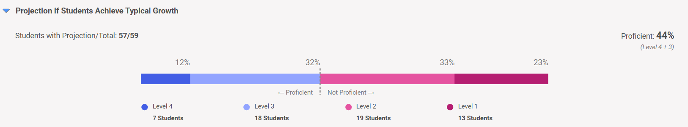

Slide 14
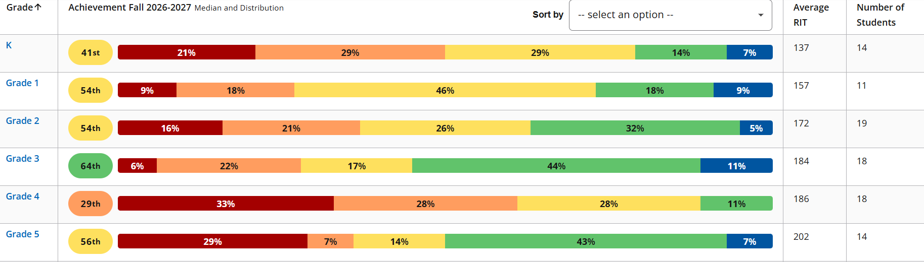
Math

Slide 15
Math Growth

Slide 16
Rimrock Jr/Sr High School Report

Slide 17
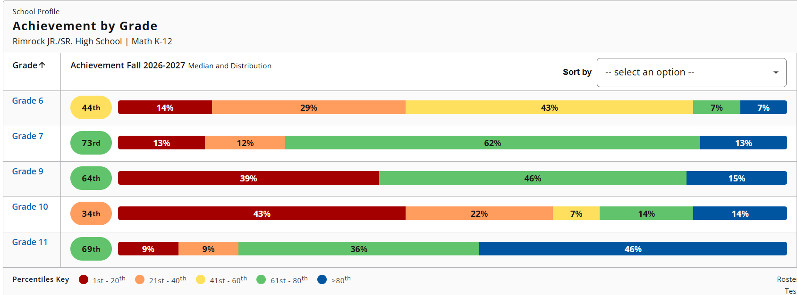
2026 Rimrock MAPS Fall Testing Math BASELINE

Slide 18
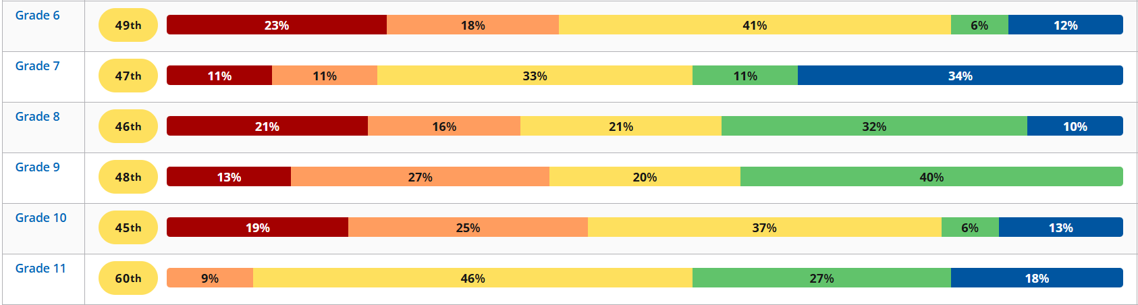
2026 Rimrock MAPS Reading Fall BASELINE

Slide 19

2026 Rimrock MAPS Testing Language Usage BASELINE

Slide 20
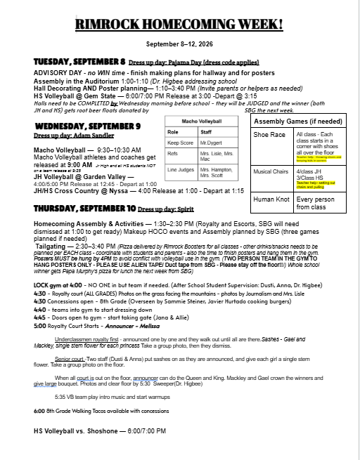

Slide 21
Rimrock Jr/Sr High School Enrollment
PreK 14
K 15
1st Grade 11
2nd Grade 21
3rd Grade 18
4th Grade 20
5th Grade 20
6th Grade 22
7th Grade 11
8th Grade 21
9th Grade 15
10th Grade 16
11th Grade 12
12th Grade 20
BGVSD Student Total= 236

Slide 22
Staff Shout Outs:
Brandi Lisle
Haden Griggs
Stephanie Danner
Sariah Pearson
Zack Dygert
Ashley Merrick
Thank you for helping Rimrock by using your experience to fill in the gaps. I am grateful to you!

Slide 23
Superintendent Updates
Student Participation:
Cross Country: HS 8 JH 11
Volleyball: HS 13 JH 16
Soccer Co-Op: HS 1 Dominic Ontiveros
Football Co-Op: HS 2 Justin Yetzer, Mauricio Lopez
Intramural Football JH- 13 4/5 Grade- 11
Access Easement- Board Approval for Ryan Jantz to file it.
Blue Cross of Idaho Shortfall
Projects
Bleachers Grand View ES
ISBA Conference
Update Bell Systems/Emergency Systems- ALL Schools

Slide 24
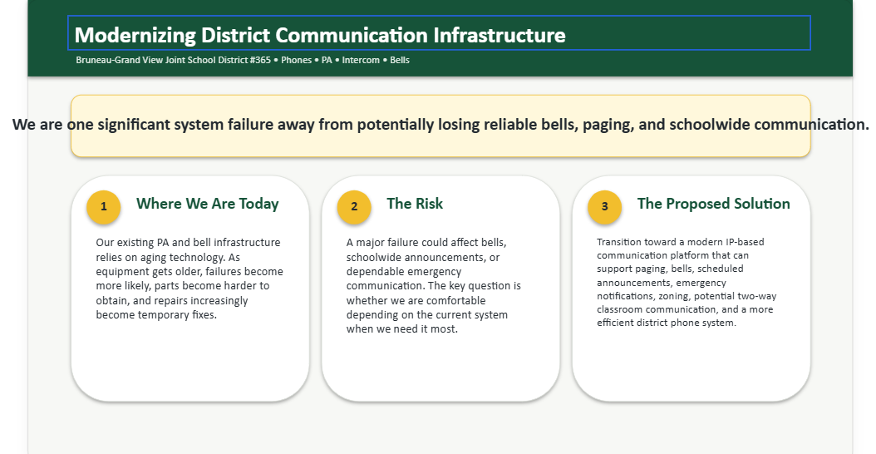
Update Bell/ PA/ Emergency Systems

Slide 25
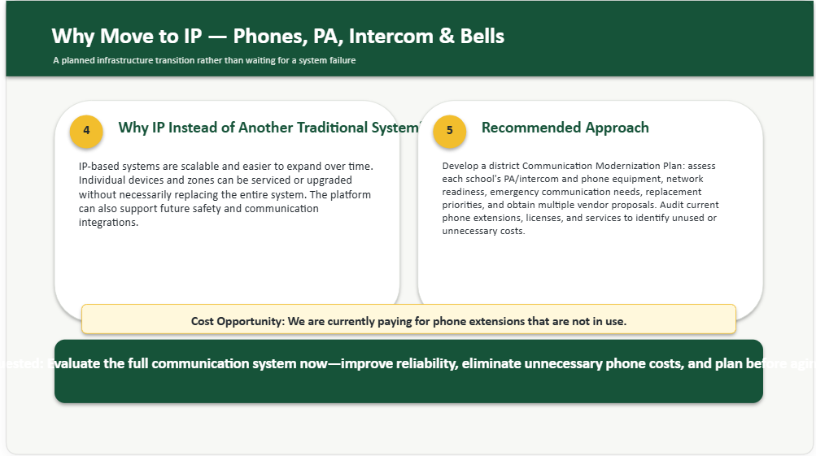

Slide 26


Slide 27
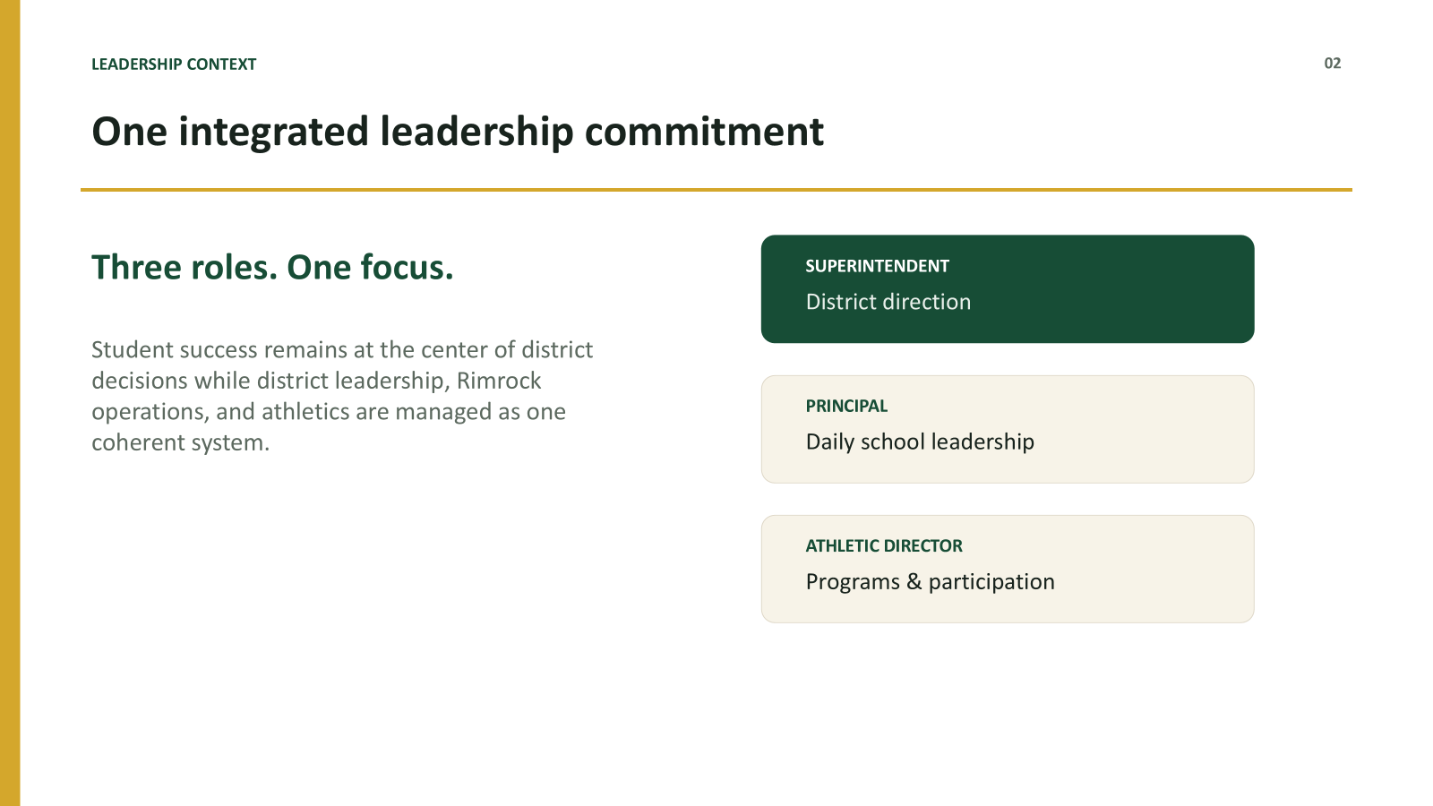

Slide 28
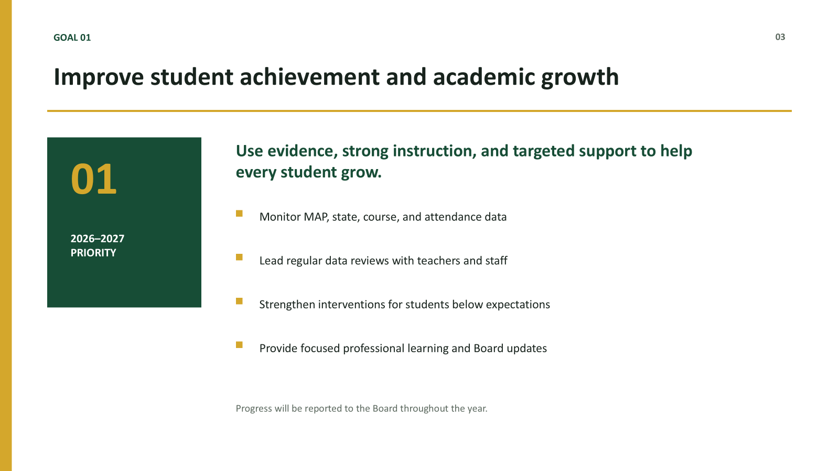

Slide 29
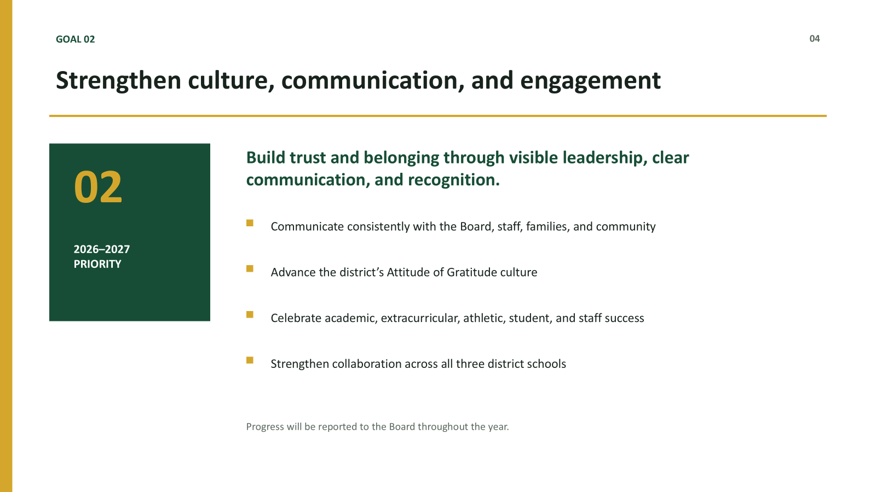

Slide 30
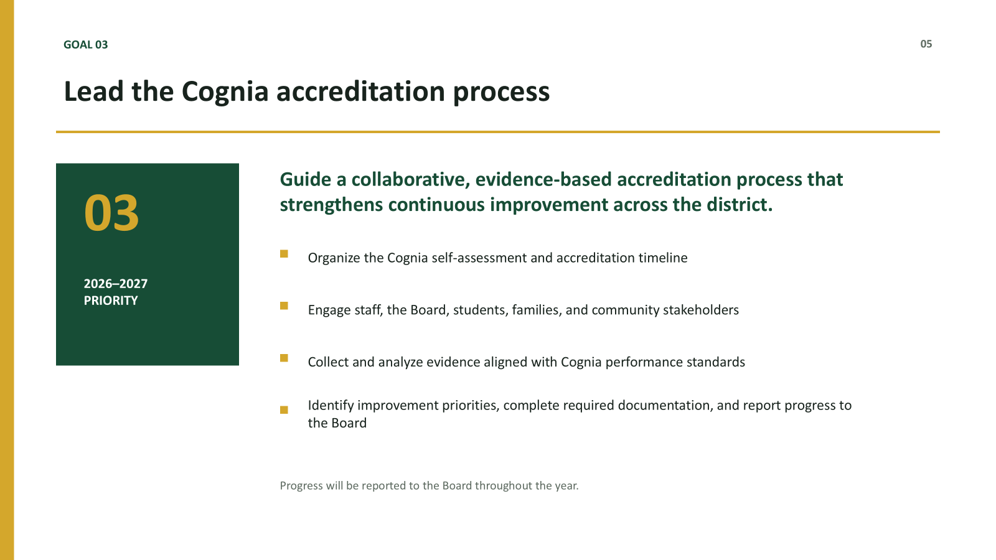

Slide 31
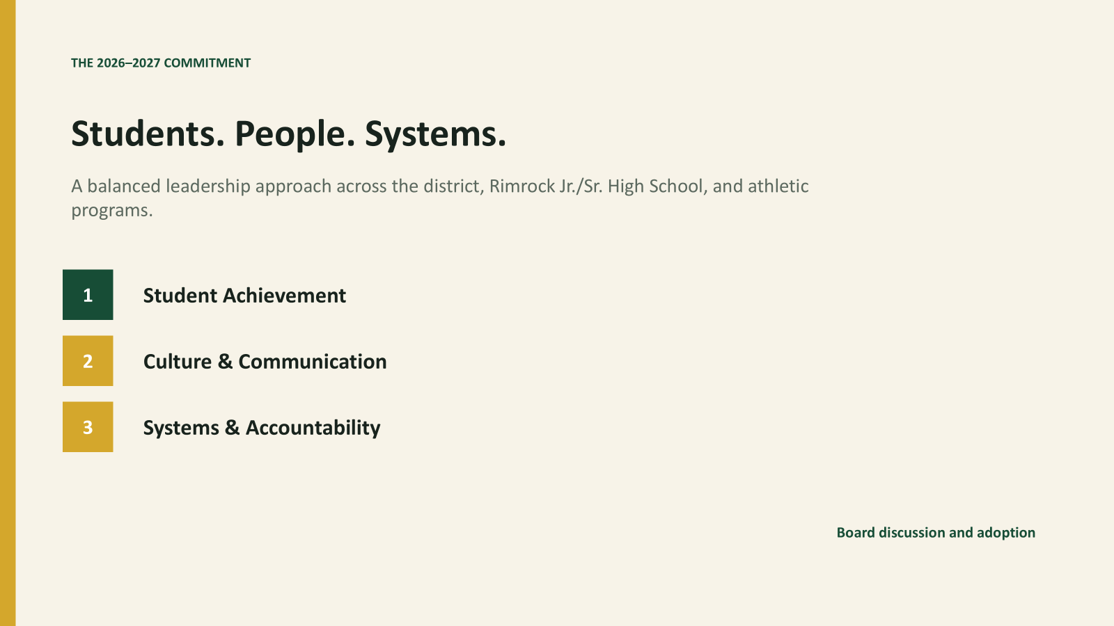

Slide 32
Executive Session

Slide 33
Action Items
  Approve or deny the Open Enrollment application of
  Student A and B.
  Approve Ingress/Egress Easement Agreement with Ryan Jantz
  Motion to approve payment of the Merrick Diesel Solutions invoice
  Approve 2025-2026 Audit
  Approve Superintendent Goals for 2026-2027

Slide 34
Adjourn

