Slide 1



May 12, 2026
7:00 PM Rimrock High School Library

Slide 2



Rimrock Principal Celebrations of Success

Slide 3
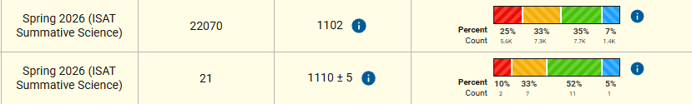
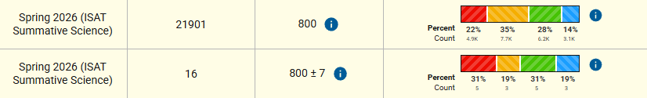
Rimrock Academics
Class of 2026:
Graduation is Saturday, 23 May at 2:00 PM (Board requested to arrive at 1:30 PM)
10/10 anticipated to graduate
3 still considered at-risk for grades (D’s in required classes)
Spring 2026 ISAT Results
11th Grade Science
STATE
DISTRICT
8th Grade Science
STATE
DISTRICT
57% Proficient
Last Year: 36%
50% Proficient
Last Year: 36%

Slide 4
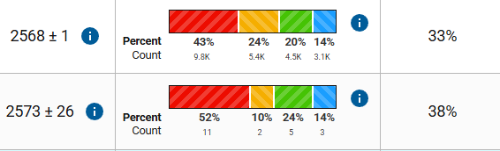
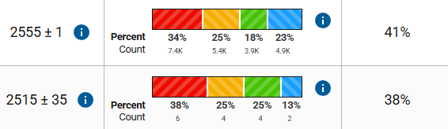
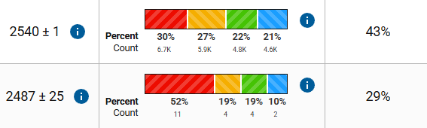
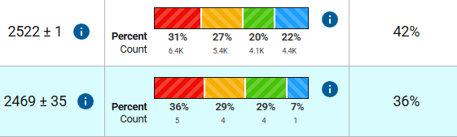
Rimrock Academics
11th Grade Math
STATE
DISTRICT Las Last Year: 21%
8th Grade Math
STATE
DISTRICT Last Year:18%
7th Grade Math
STATE
DISTRICT Last Year: 53%
6th Grade Math
STATE
DISTRICT Last Year: 18%

Slide 5
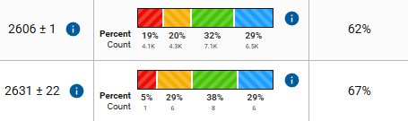
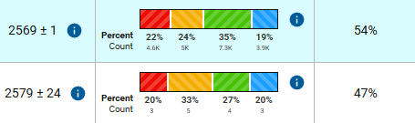
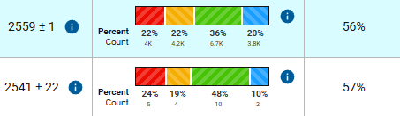
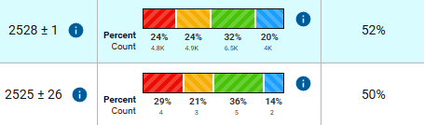
Rimrock Academics
11th Grade ELA
STATE
DISTRICT Last Year: 50%
8th Grade ELA
STATE
DISTRICT Last Year: 30%
7th Grade ELA
STATE
DISTRICT Last Year: 55%
6th Grade ELA
STATE
DISTRICT Last Year: 41%

Slide 6
Rimrock Behavior & Culture
Athletics:
Golf: 1 State Qualifier…Dylan McNeley (competed yesterday/today)
Track: 6 State Qualifiers…compete on 15/16 May at Middleton HS
Current Enrollment: 121 (-1)
Attendance: Avg Daily Attendance: 92% (for year) / 93% (for April); Goal: 95%
Behavior: 8 BRtI referrals in April (~0.6 per day); Goal: <1 per day
Significant Upcoming Activities & Events at Rimrock:
9th Grade Field Trip to Bruneau Dunes / Gingerich Farms (tomorrow, 13 May)
Honor Roll Field Trip to Boise Zoo (Thursday, 14 May)
6th Grade Orientation (19 May in AM), followed by Elementary Field Day
Academic Awards Assembly (20 May, 2:15 PM)
Rimrock Field Day & Last Day of School (21 May)
Graduation (23 May, 2:00 PM)
Employee Recognition: Christine Meyers
Makes daycare possible, supporting our teachers with safe, reliable childcare for their kids
Filled in several days as secretary at front desk this Spring (full-time Rimrock secretary next year)
Graduation organizer - makes sure everything happens on time and professionally!

Slide 7
Elementary Principals Celebrations of Success

Slide 8
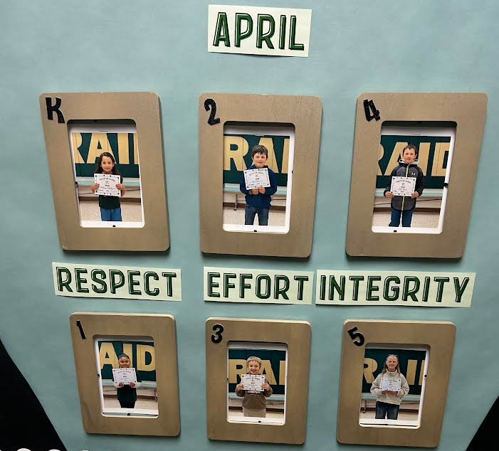
Grand View Elementary Students of the Month
Bethany Theodozio Grant King Ryan Brum
Lexi Herrera Isaiah Sparks Freya Williams

Slide 9
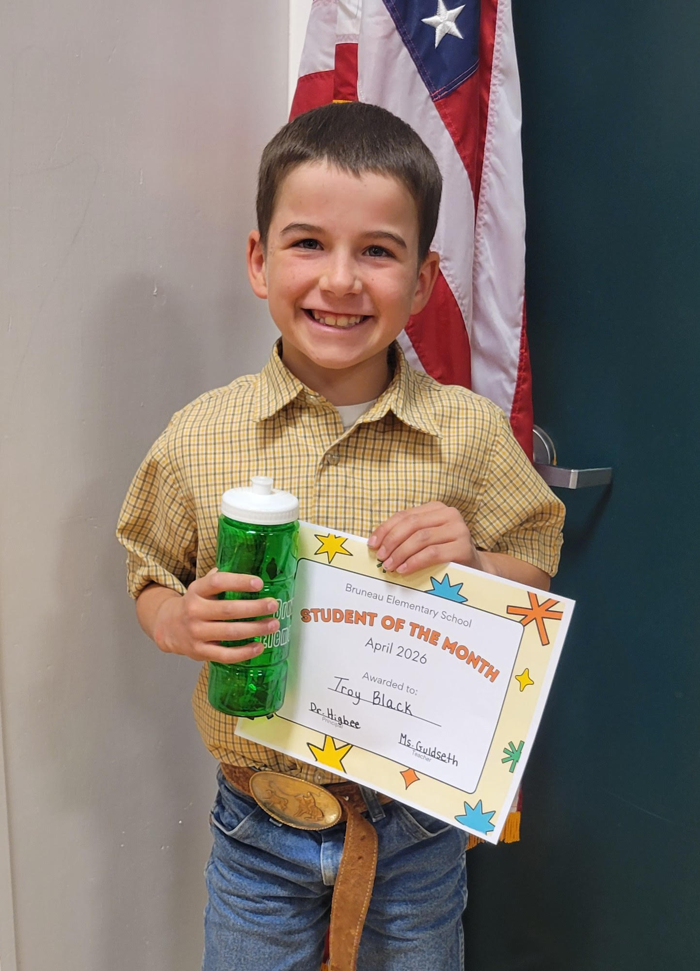
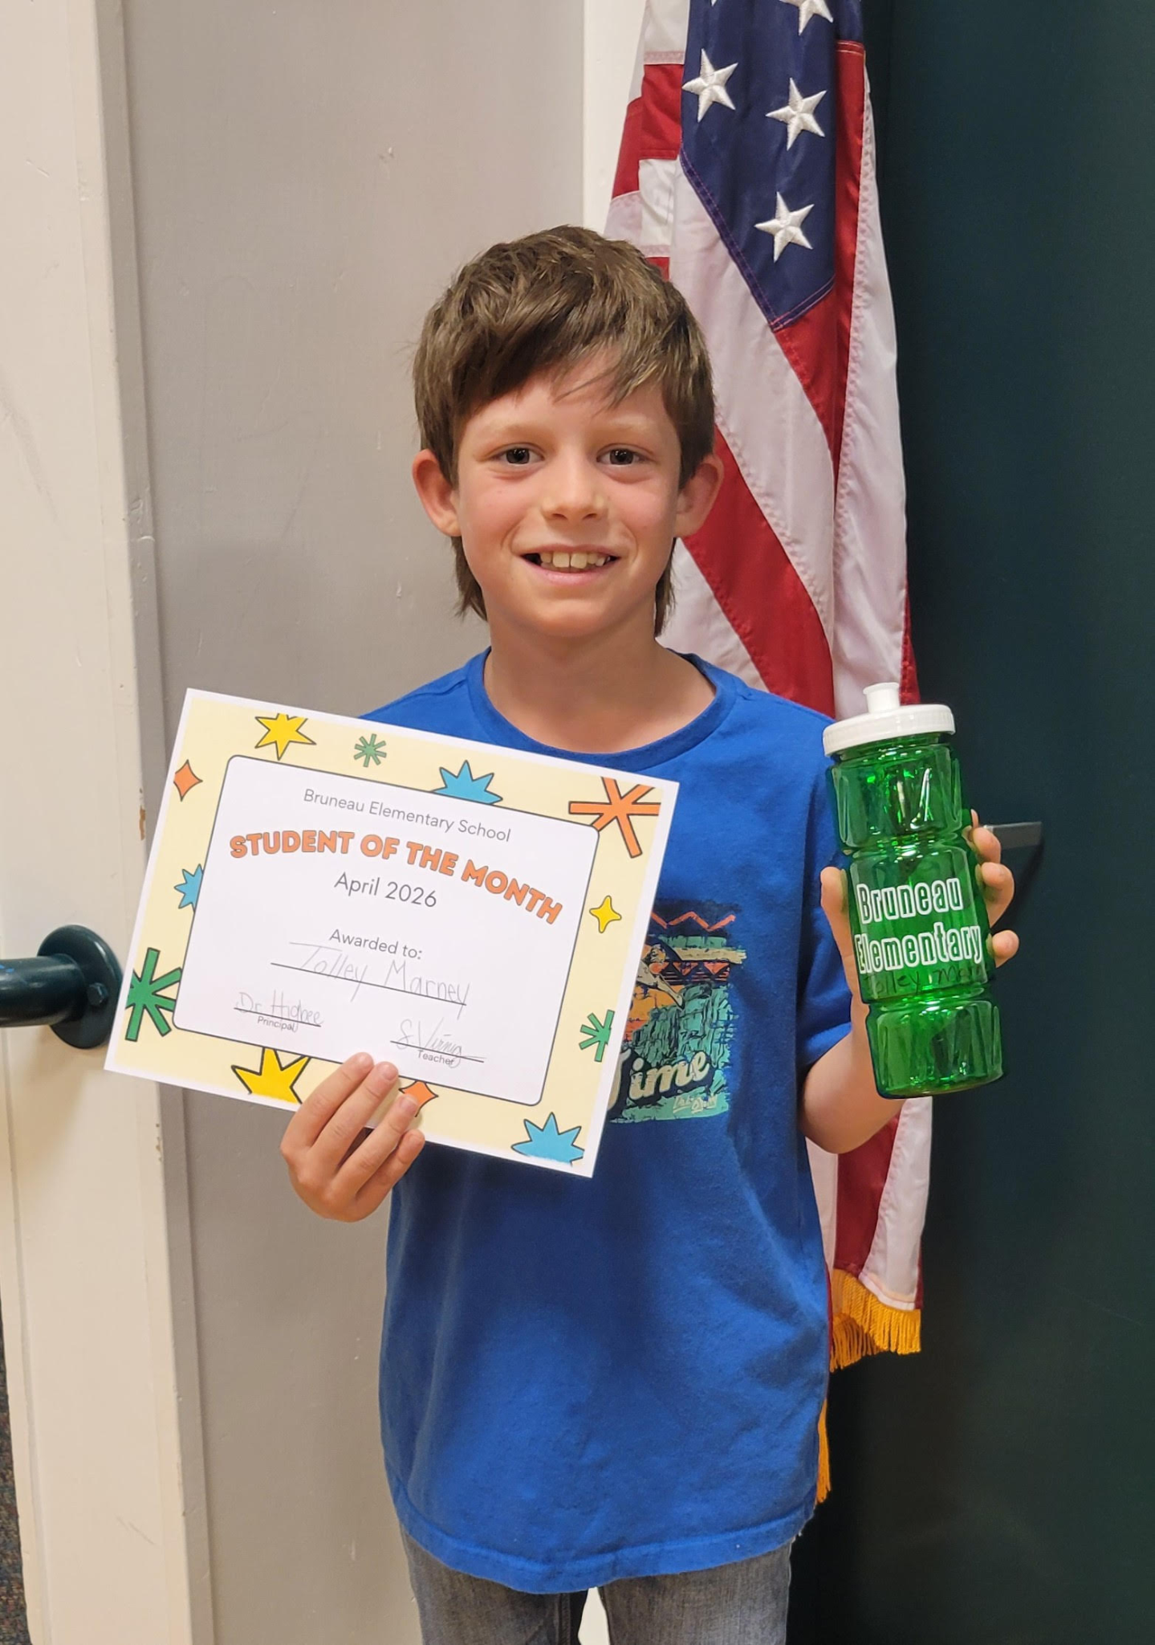
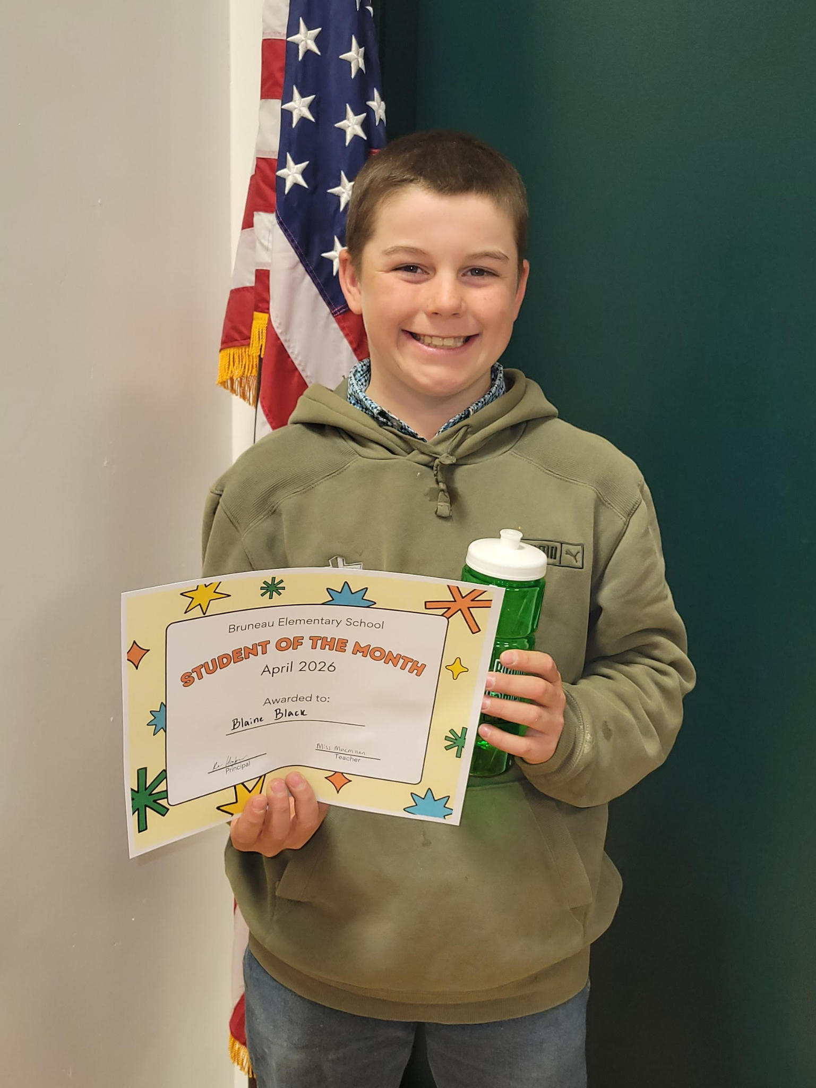
Bruneau Elemetary School Students of the Month
Troy Black Tolley Marney Blaine Black

Slide 10
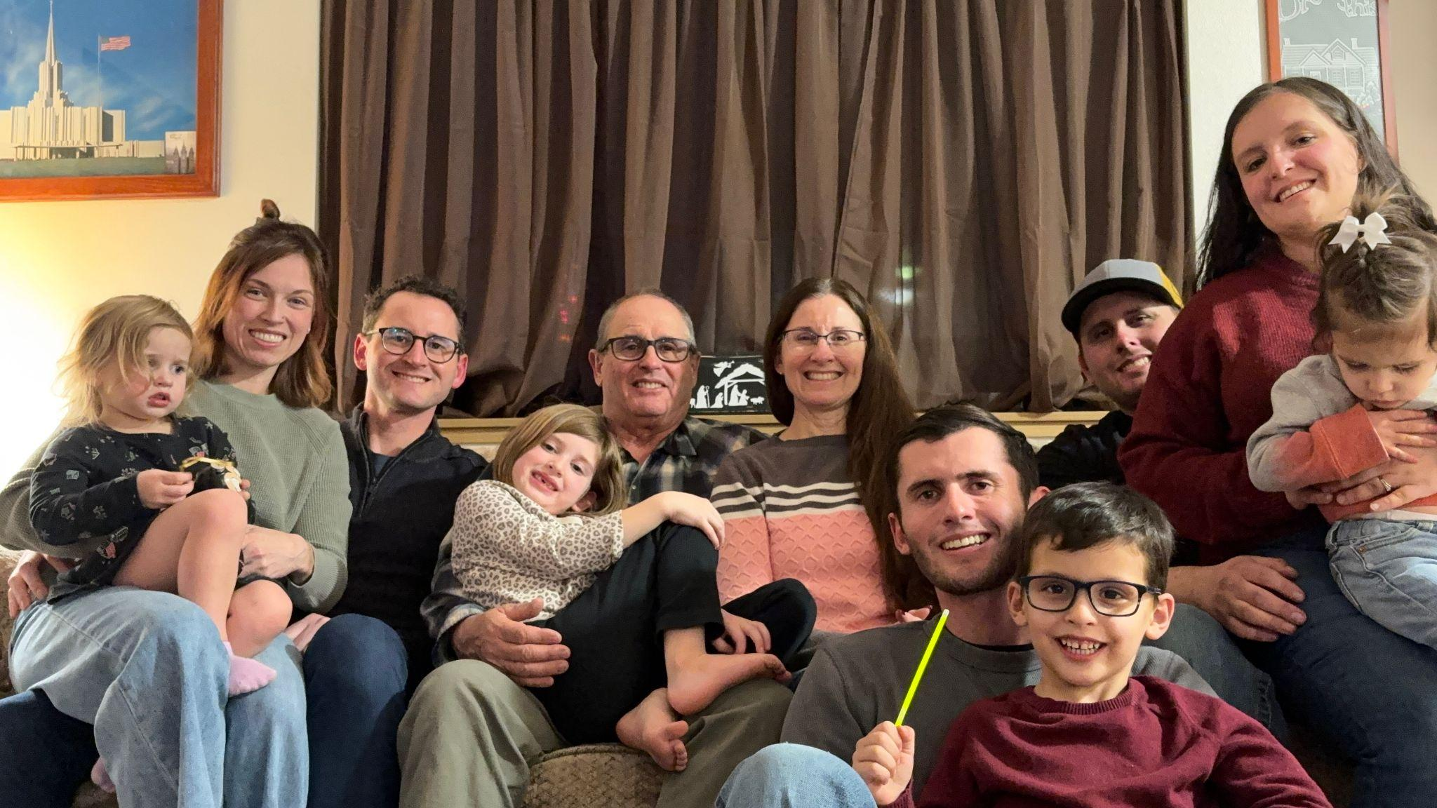
GVE Staff Spotlight - Bonni Draper
 | 7:53 AM (5 hours ago)
Bonni was born and raised in California but has spent the majority of her life in Grand View, Idaho with her husband Robert for the past 43 years. Together they have raised 3 boys, all of which are graduates of Rimrock High School. Her time spent in the school district started back in the mid 80's where she was hired as a teacher's aid for a year in the 4th grade class of Merla Deeds also spending a bit of time substituting in the next few years. She spent many years after that helping in her children's classes and also as a Cub Scout leader. It wasn't until 2006 that she became hired full-time as a Paraprofessional teaching in PreK and working in Special Ed. For 15 years she had the privilege and joy of working in the classroom with many wonderful students in their early first years of school. In 2022 she was given the opportunity to experience a different dynamic in the school, that of Administration Assistant, and has now completed 5 years in this role. She considers being able to associate with all the students, their parents, and staff as a pleasure. Her hope has always been to help the students feel joy and confidence in themselves and to know they are safe and wanted at school. This year will mark 20 years as an employee and member of the Bruneau-Grand View School District family/team. Her favorite things to do outside of work are spending time with family and friends, hosting gatherings, jeeping with Robert, traveling, playing with grandkids, listening and singing with the radio, playing the piano, housekeeping and gardening, reading when able, going on parts run dates, and trying to keep up with Robert!

Slide 11
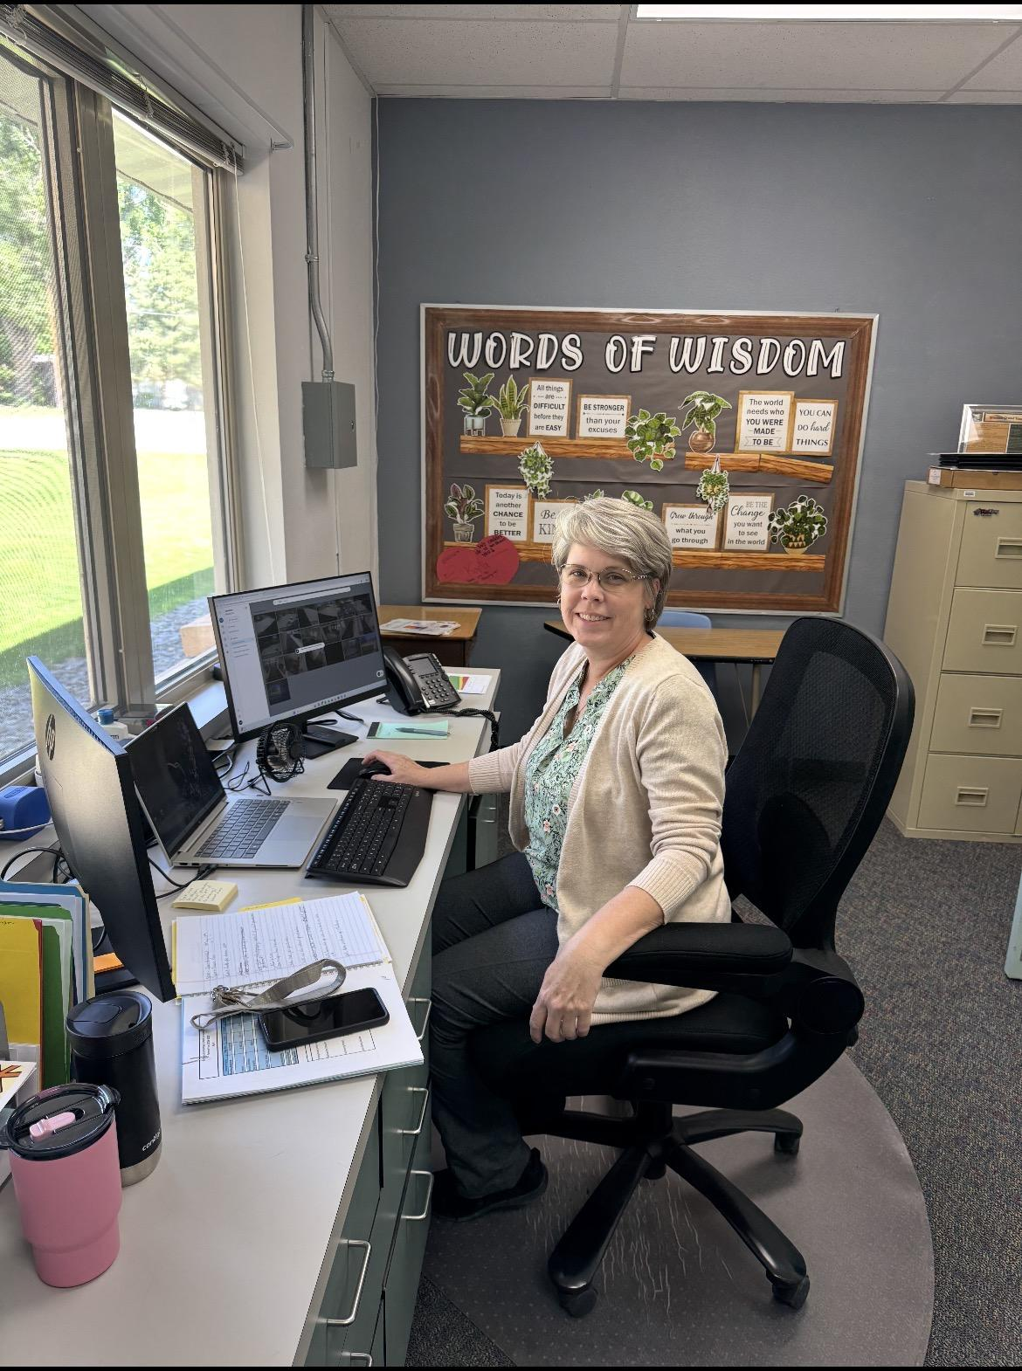
Bruneau Elementary
Staff Spotlight
Karla Snell
Raised in Indian Cove and a 1990 Nampa Christian graduate, Karla Snell earned a business degree from Boise State before embarking on a decade-long journey as a military spouse, which included living in Japan. After her husband’s 2010 retirement, Karla balanced fifteen years of bookkeeping with time spent at home raising her two children.
Now a vital part of Bruneau Elementary, Karla is known for her unwavering willingness to help with any task. Whether she is managing office needs or stepping into the classroom, she answers every request with a smile. The true highlight of her work is watching her lead her reading groups, where her dedication to her students' success truly shines.
Outside of school, Karla stays busy gardening and tackling home improvement projects. We are incredibly lucky to have her versatile talents and dedicated spirit on our team.

Slide 12

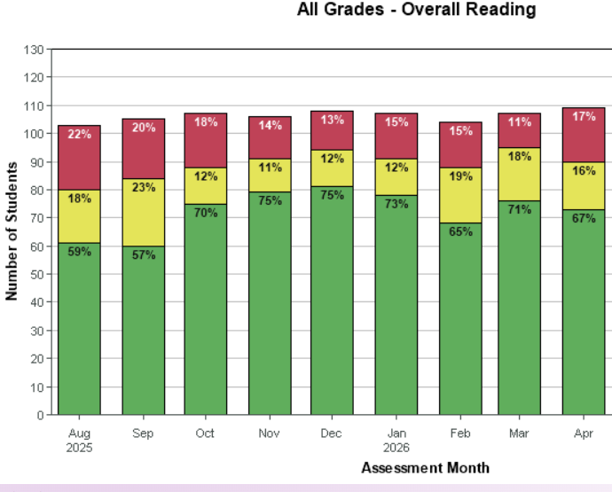

Slide 13
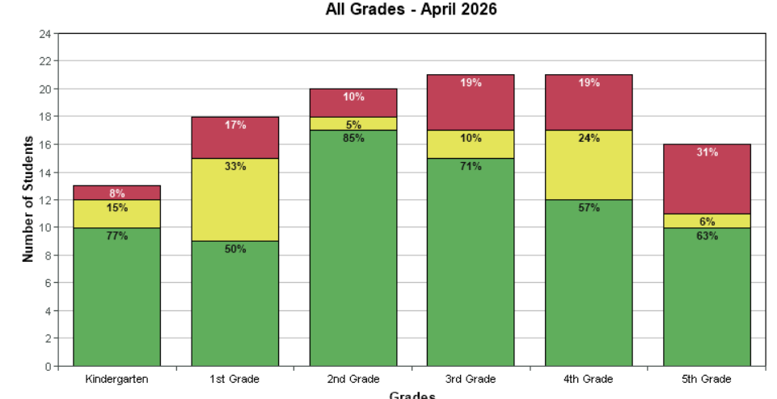

Slide 14
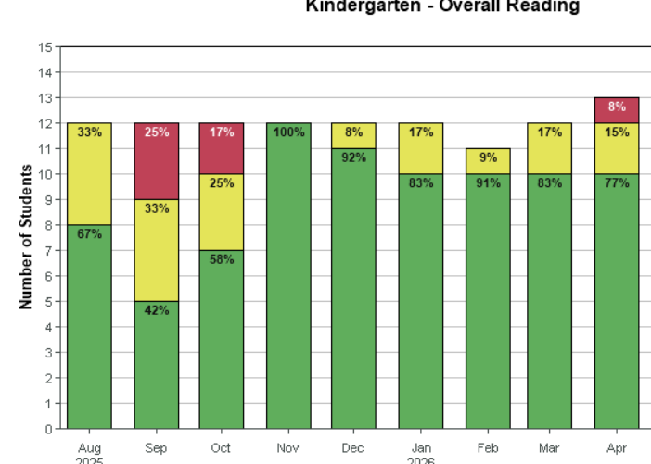

Slide 15
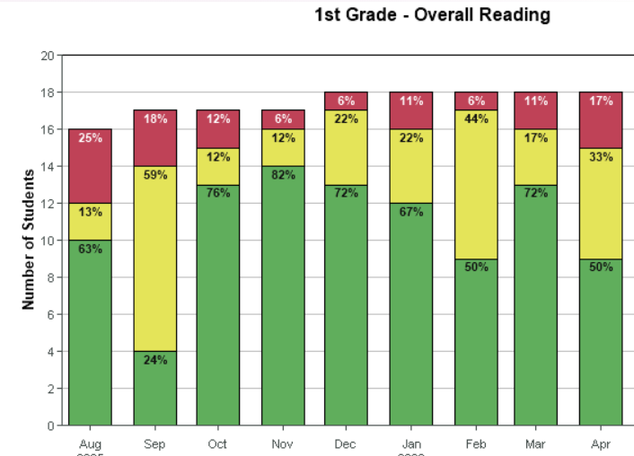

Slide 16
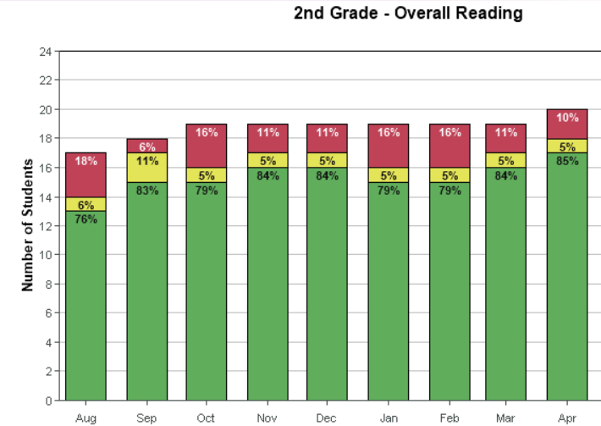

Slide 17
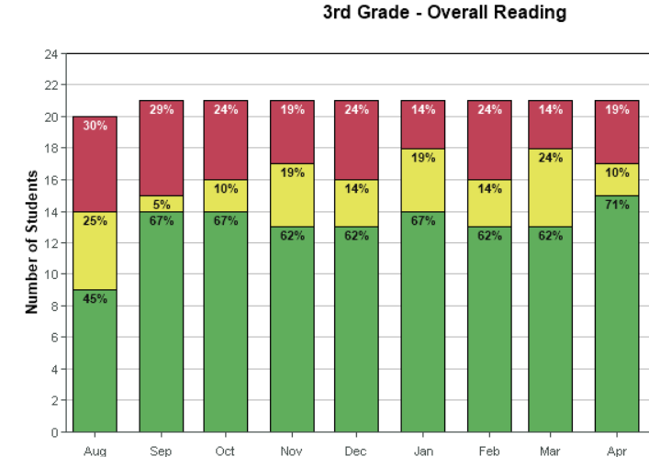

Slide 18
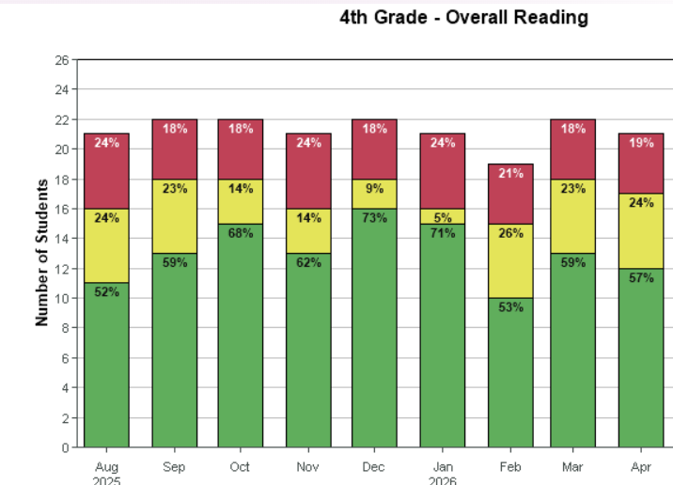

Slide 19
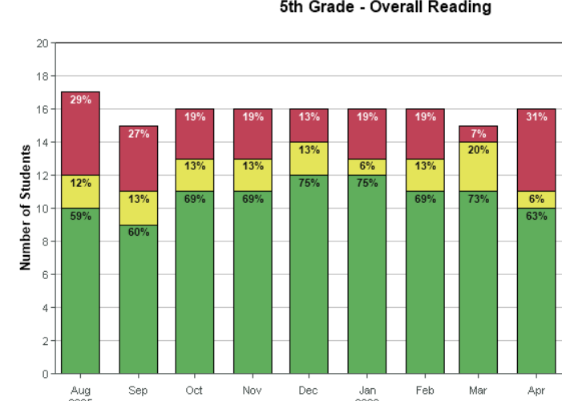

Slide 20

Annual Typical Growth
Students | 49 | 36 | 30
Descriptor | Likely | Somewhat Likely | Somewhat Unlikely
Breakdown | >70% probable | 50-70% probable | <50% probable
*grade level

Slide 21
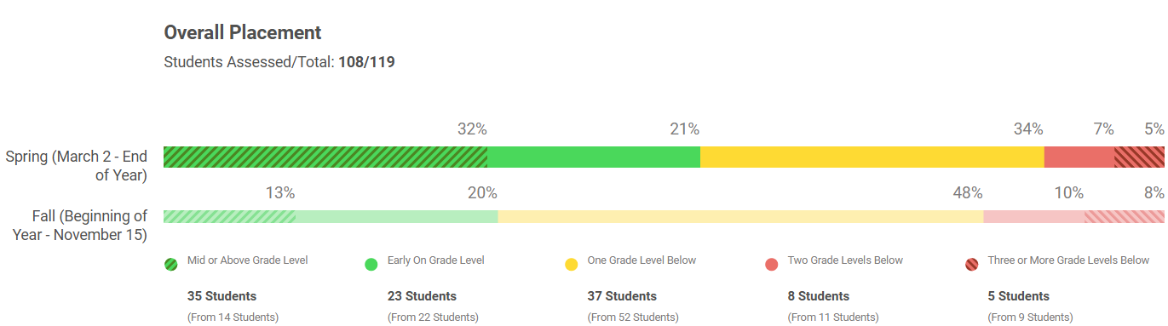

Slide 22
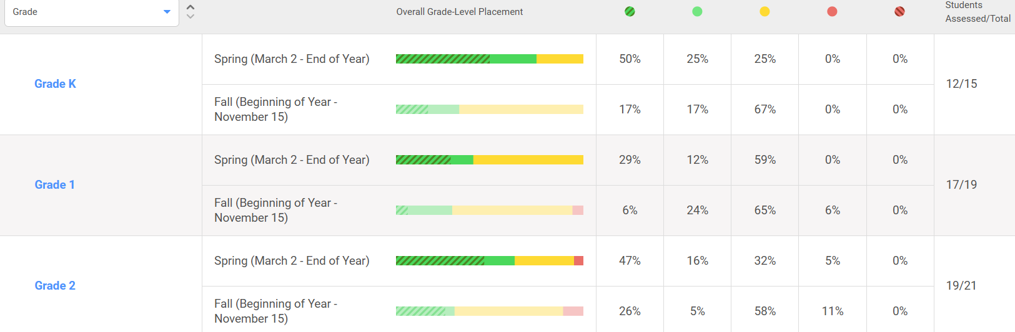

Slide 23
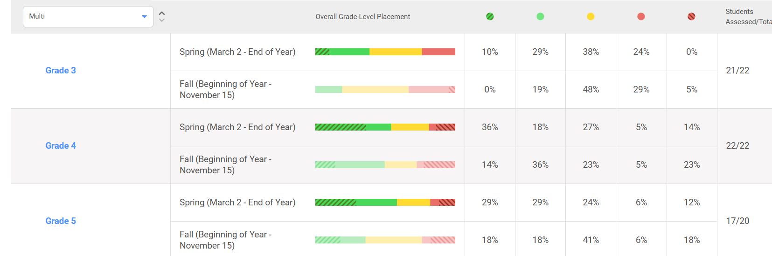

Slide 24
Screen Time
Kindergarten: 120 minutes/ Increase due to end of year testing
First Grade: IRI Testing: Minutes Varied
Second Grade: 60 Minutes
Third Grade: 120 Minutes/ increase due to testing
Fourth Grade:120 Minutes/ Increase due to testing
Fifth Grade: 180 Minutes/ Increase due to end of year testing

Slide 25
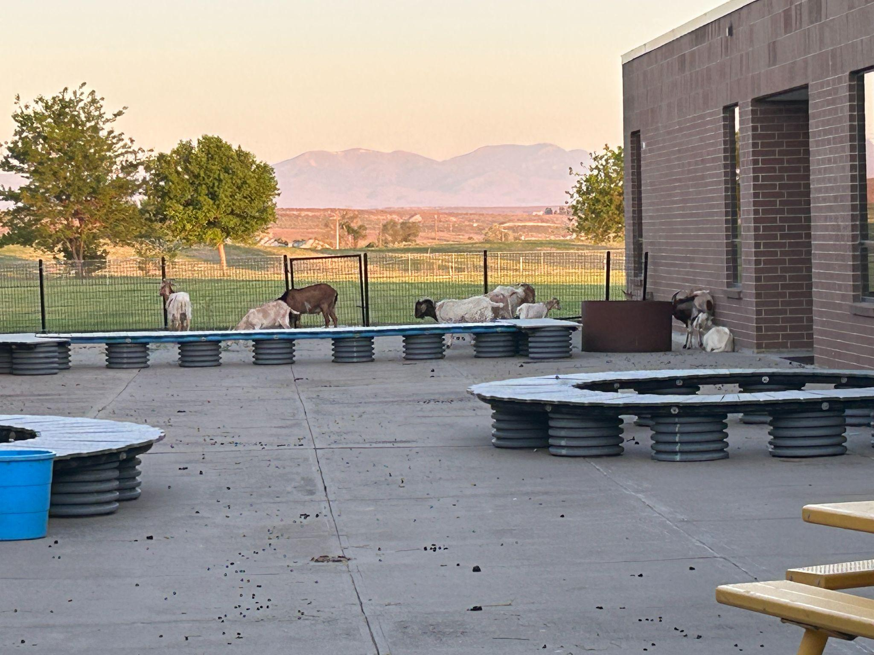
Superintendent’s Report
Class of 2026-The GOATS

Slide 26
Enrollment
GVE: no change (106- 17 PreK)-89 K-5
BES: (23)+ 1

Slide 27
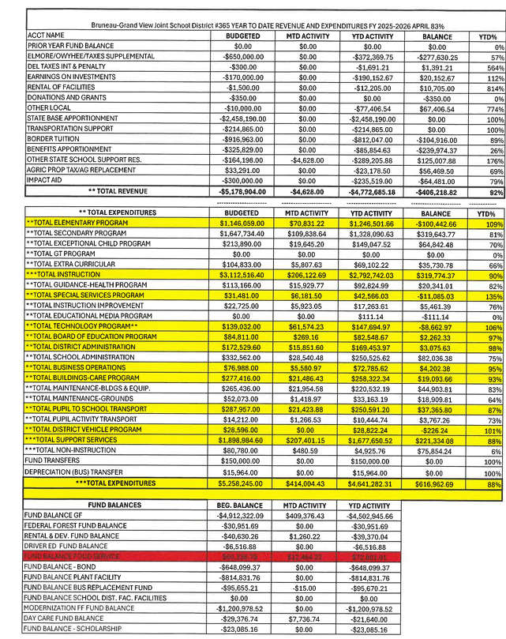
Monthly Financial Report – April
(Target goal for April is 83% in the YTD Total Column for both Revenue and Expenditures)
REVENUES (Total Revenues for April 92%)
Rental of Facilities - Daycare - 814%
Other Local (774%) - Greenhouse Grant
State Based Apportionment - (100%) - Payment from the State (Front loaded payment)
Other State School Support (176%) - State Facilities Fund $ put here
EXPENDITURES (Total Expenses 88%)
Elementary Program 109%
Total Special Service Program - 135% (OT/Speech/SLP)
Total Board of Educ. Prog. (97%) - Annual Insurance Payment, Workmans Comp., Fees
Total District Admin - 98%
Total Business Operations - 95%
Total District Vehicle (101%) - New PU
FUND BALANCE
290-Food Service - $72,801.01

Slide 28
Operations - Business Manager Report
Fund Balance: Food Service - $-72,801.01
Implemented positive pay and it is going good
Working on Budget for 2026-2027

