Slide 1


July 14, 2026
7:00 PM Rimrock High School Library

Slide 2


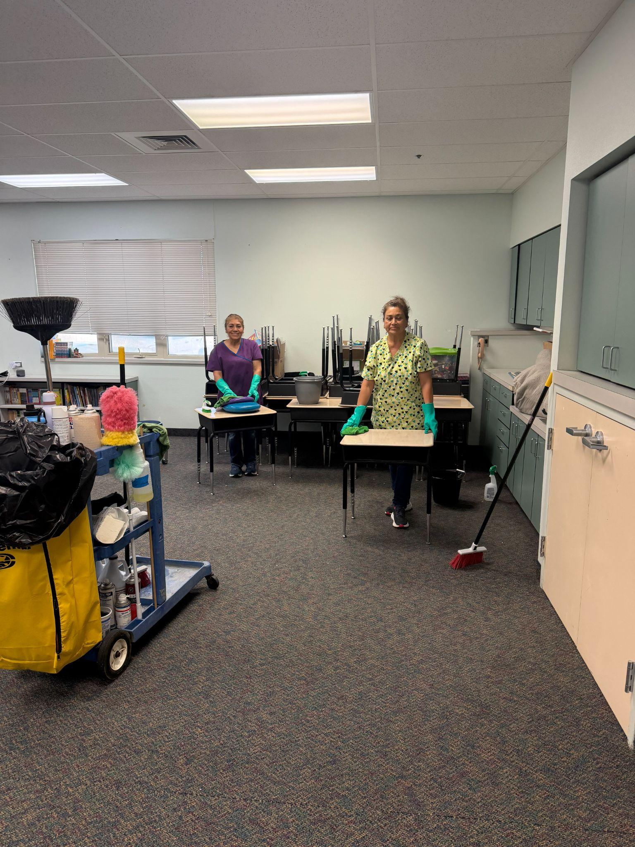
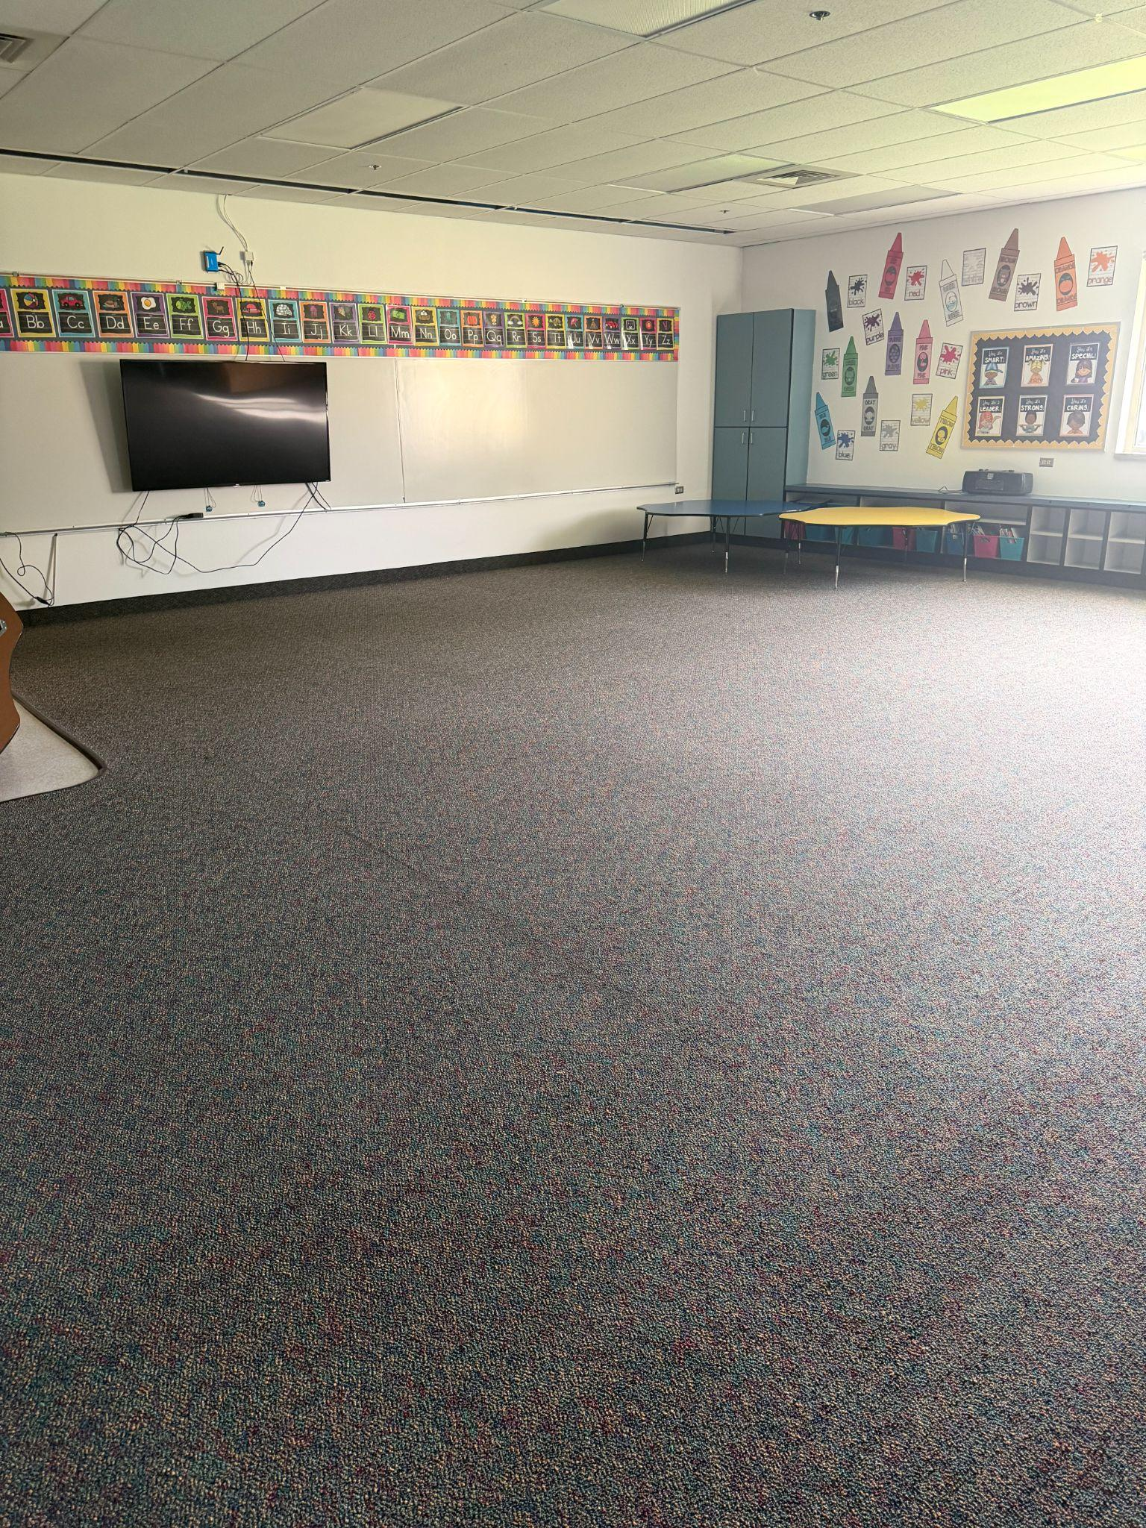
Grand View Elementary School

Slide 3
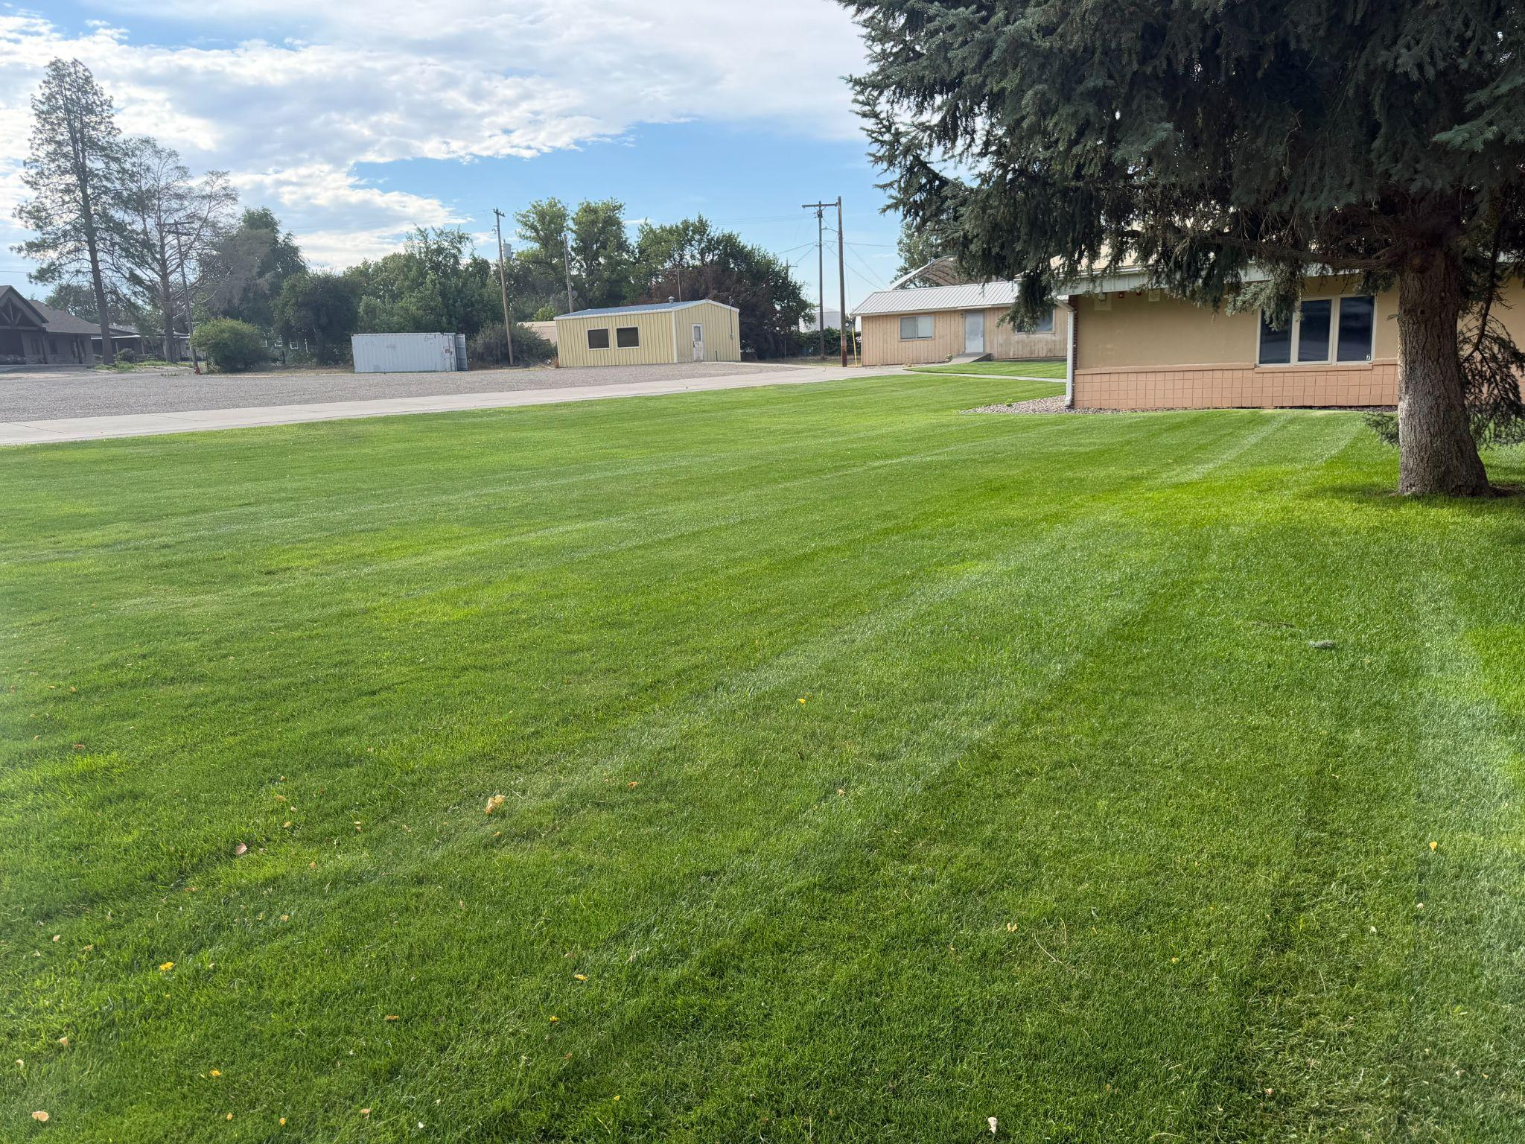
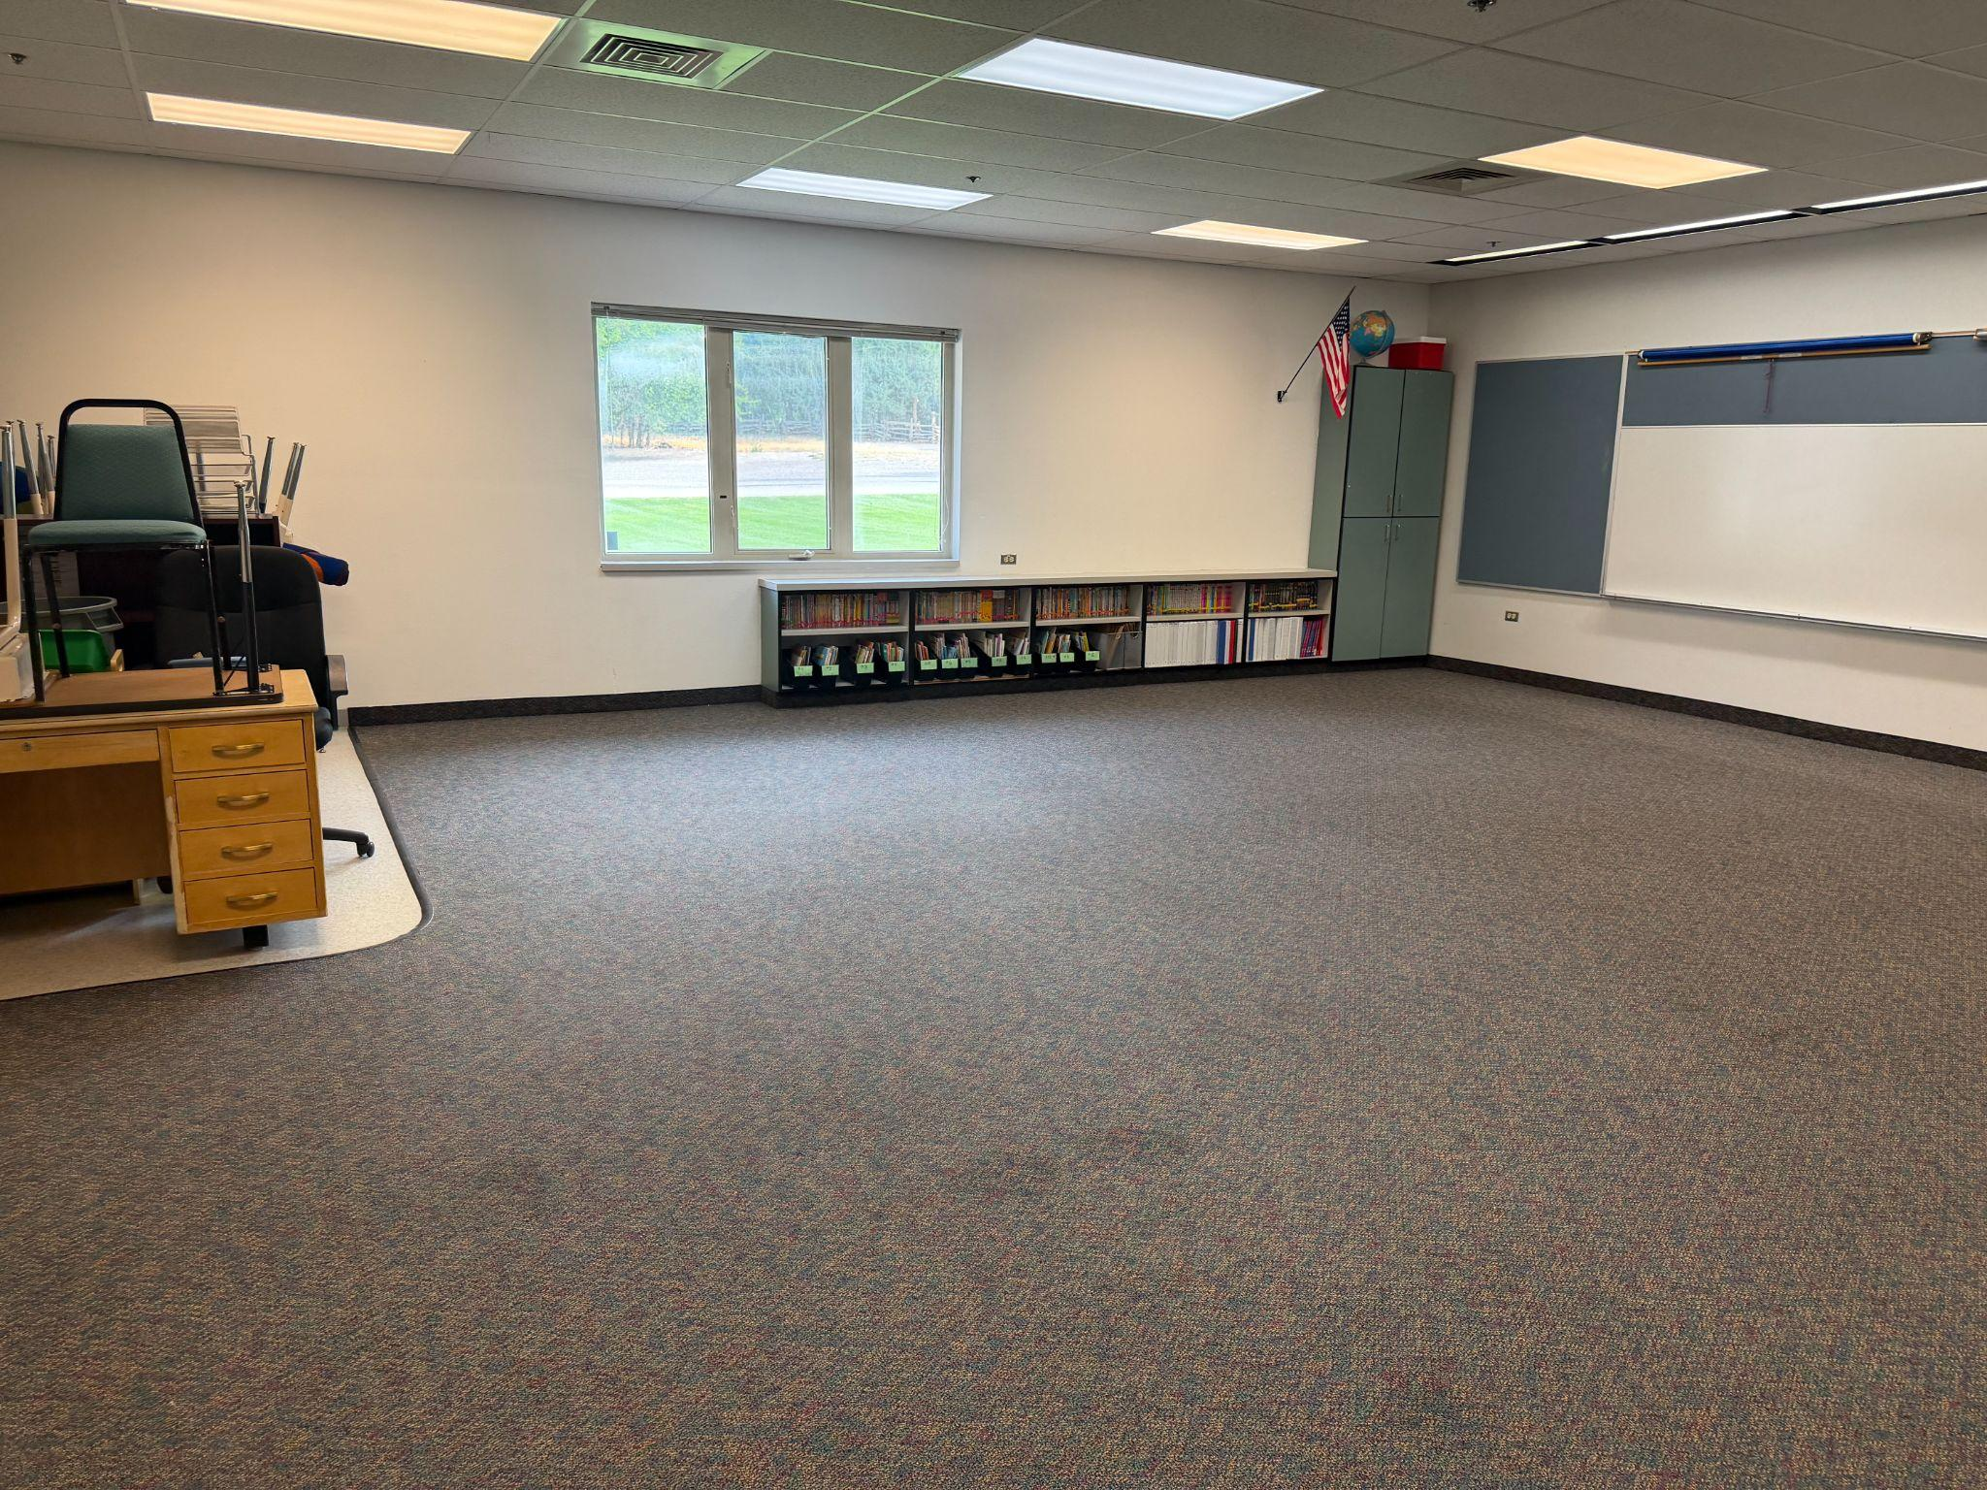
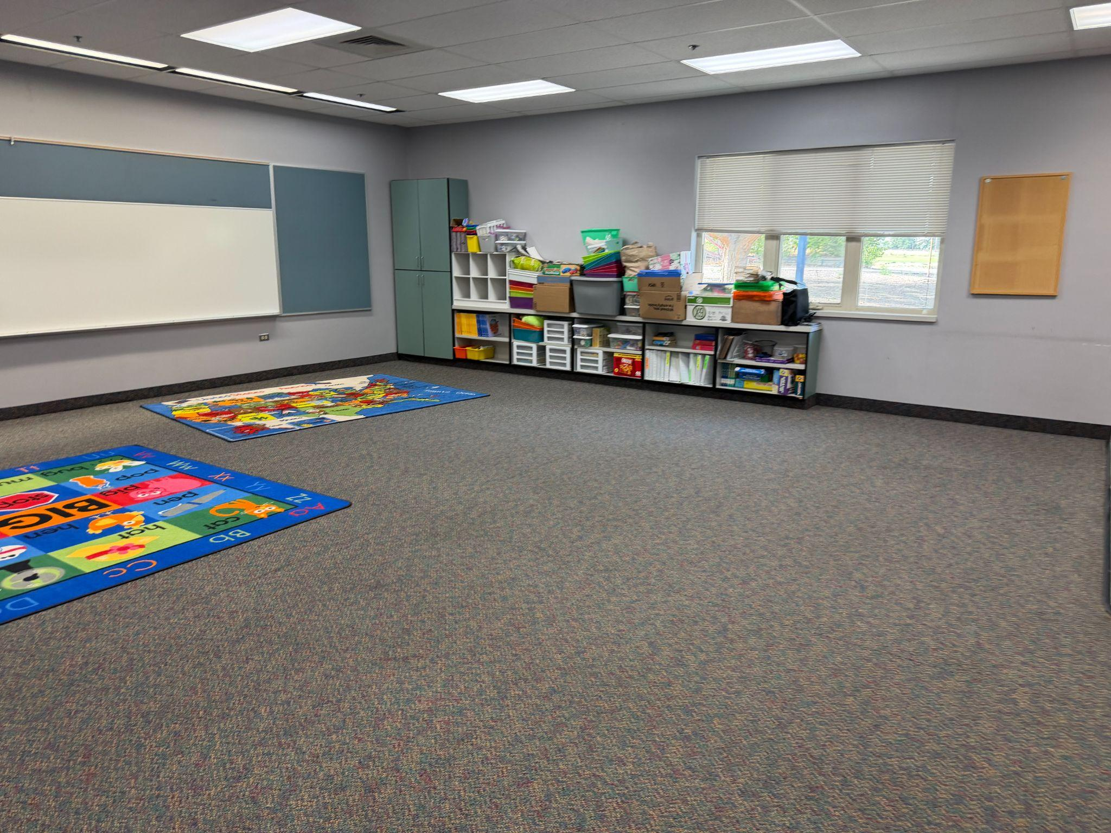
Bruneau Elementary School

Slide 4
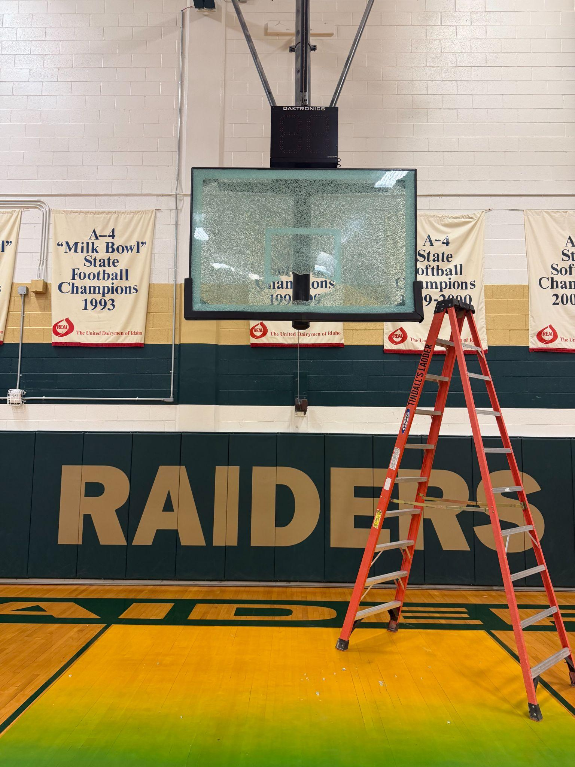
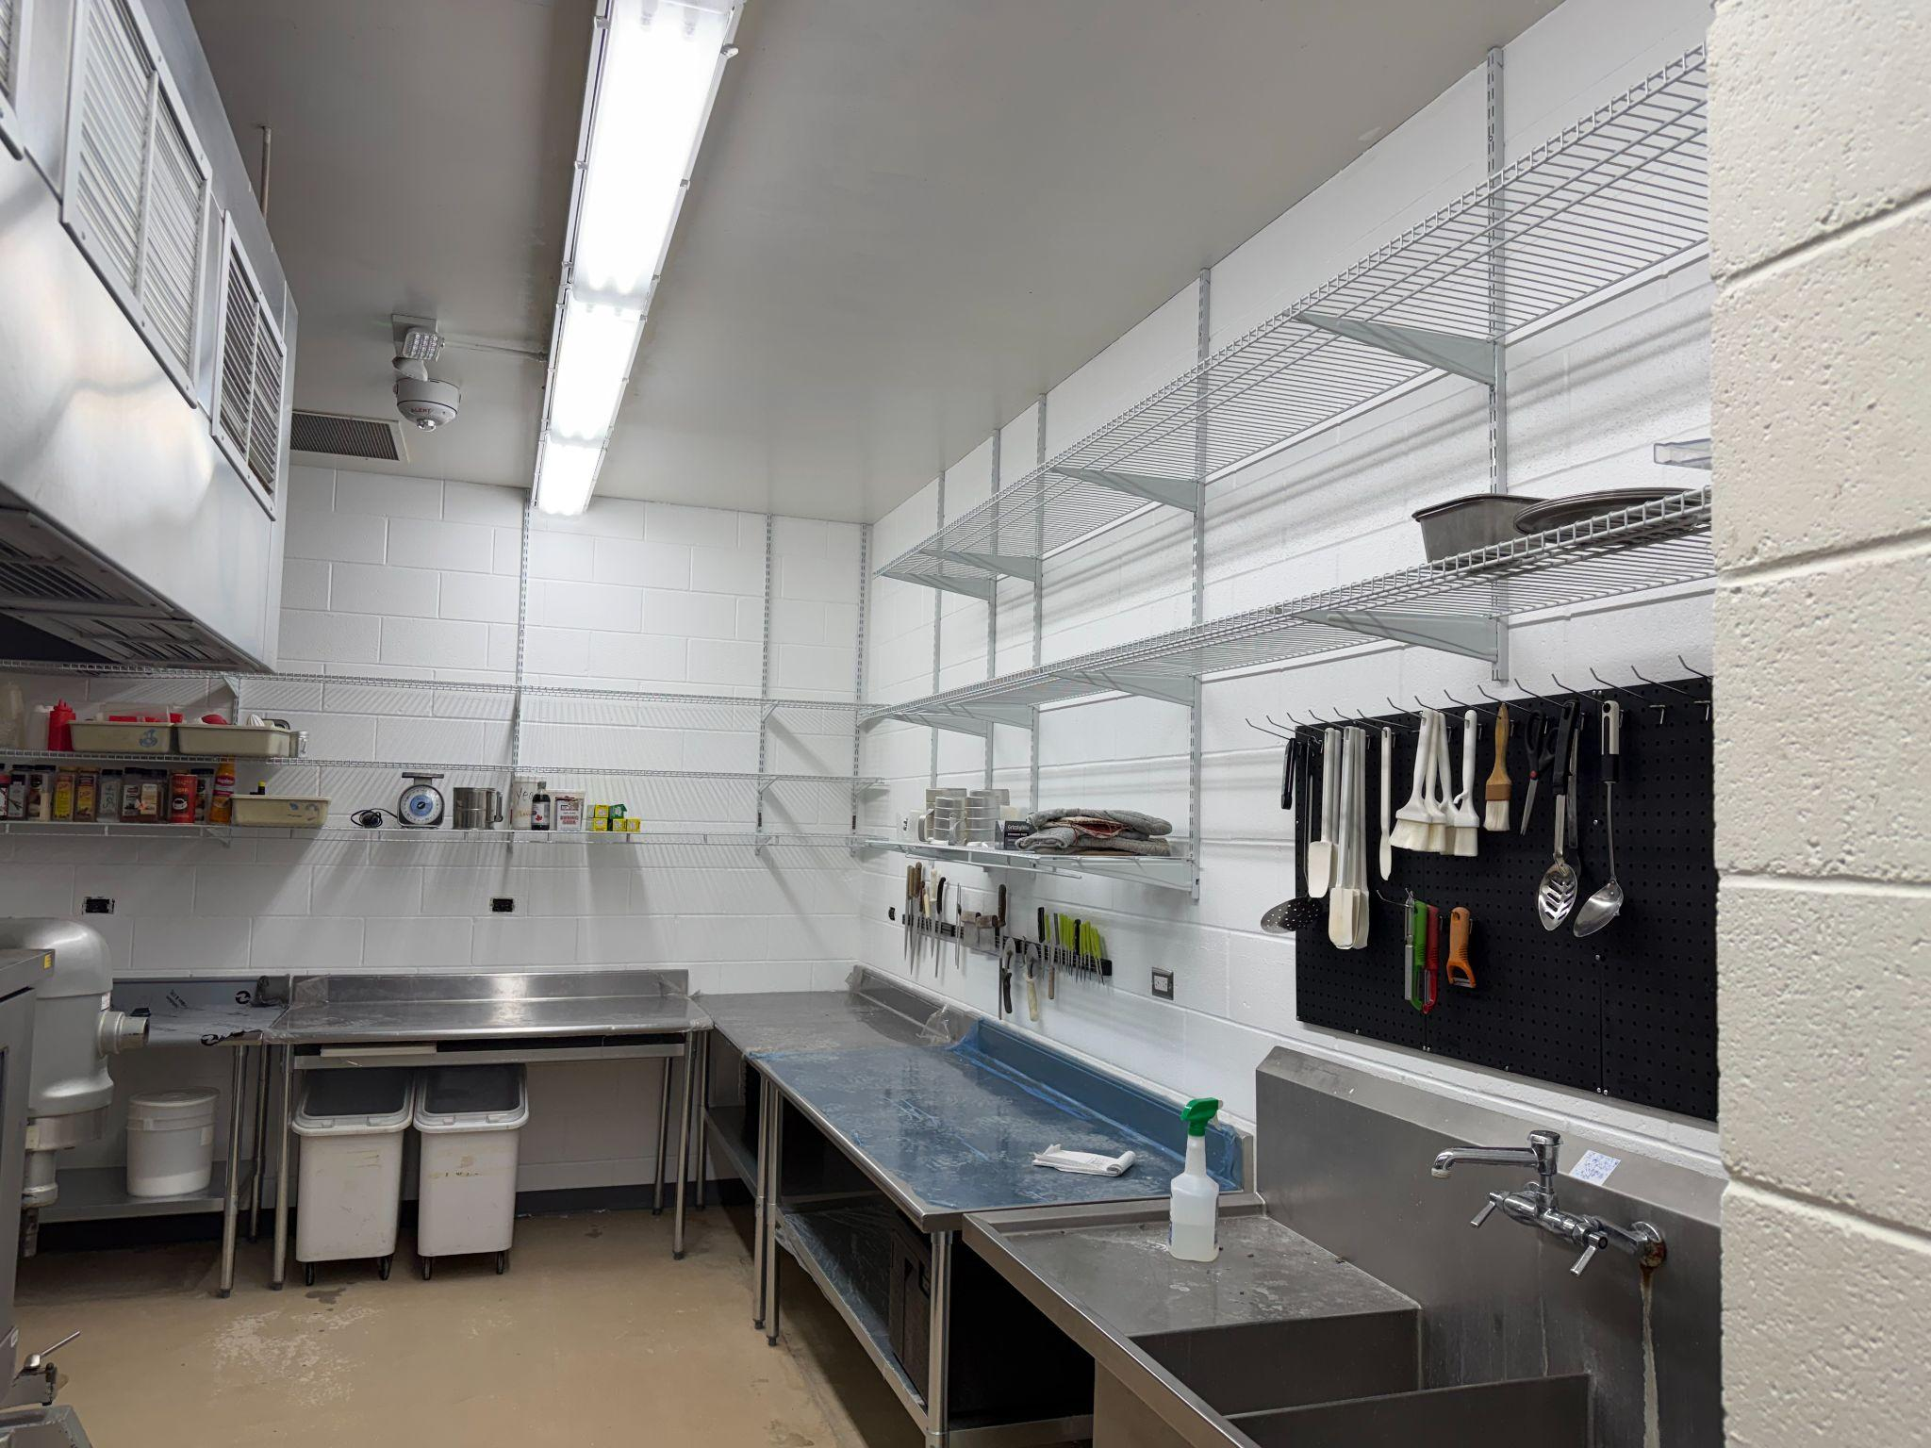
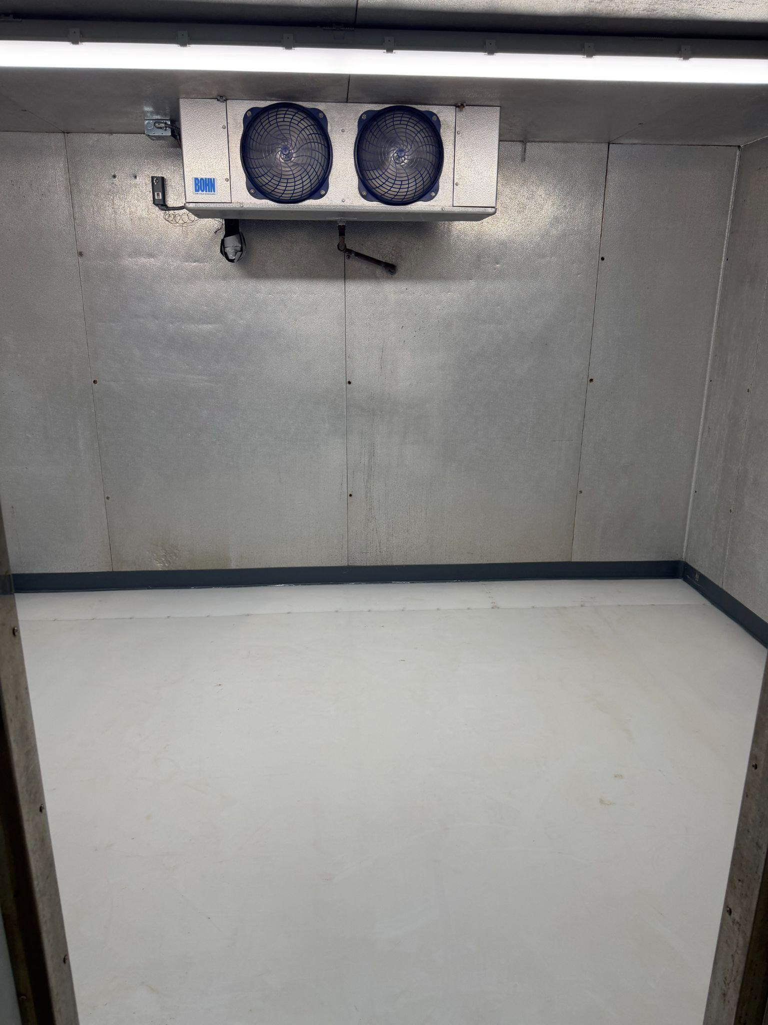
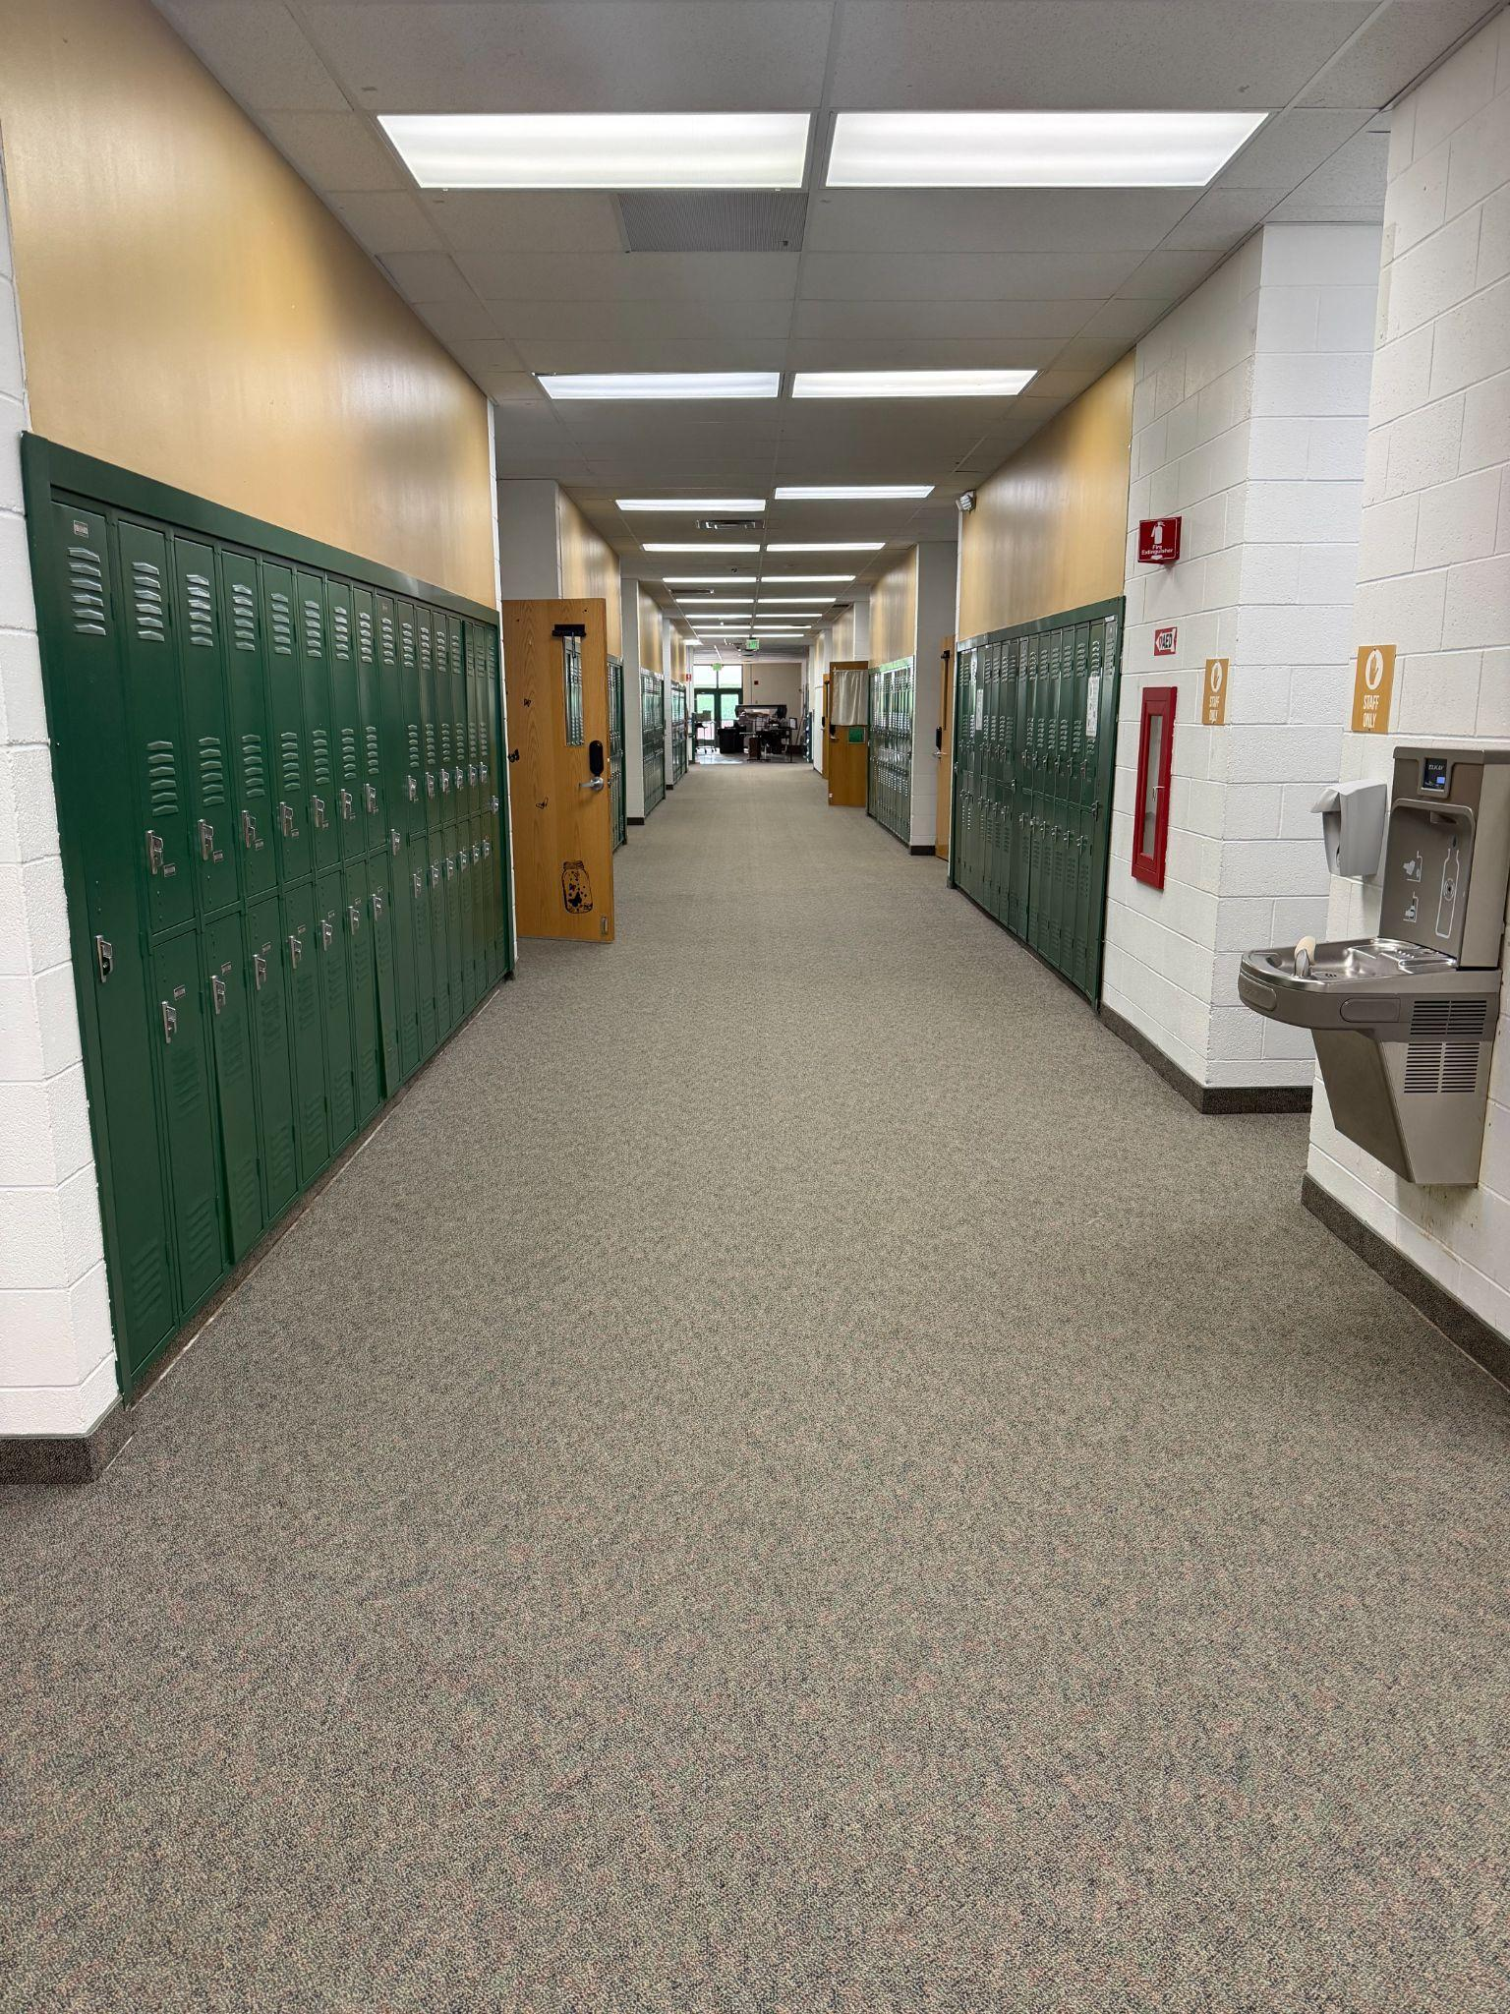
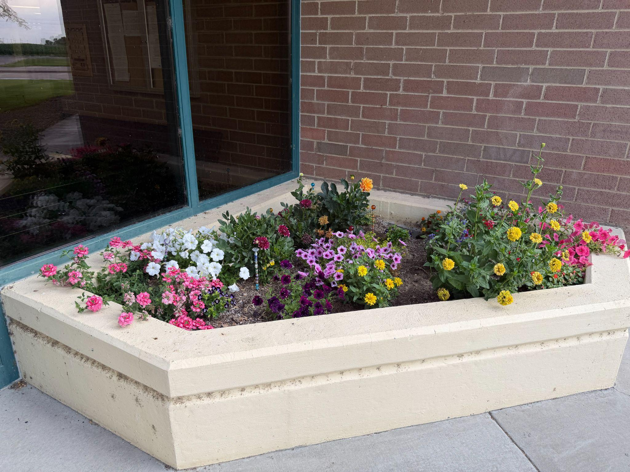
Rimrock Jr/Sr High School

Slide 5
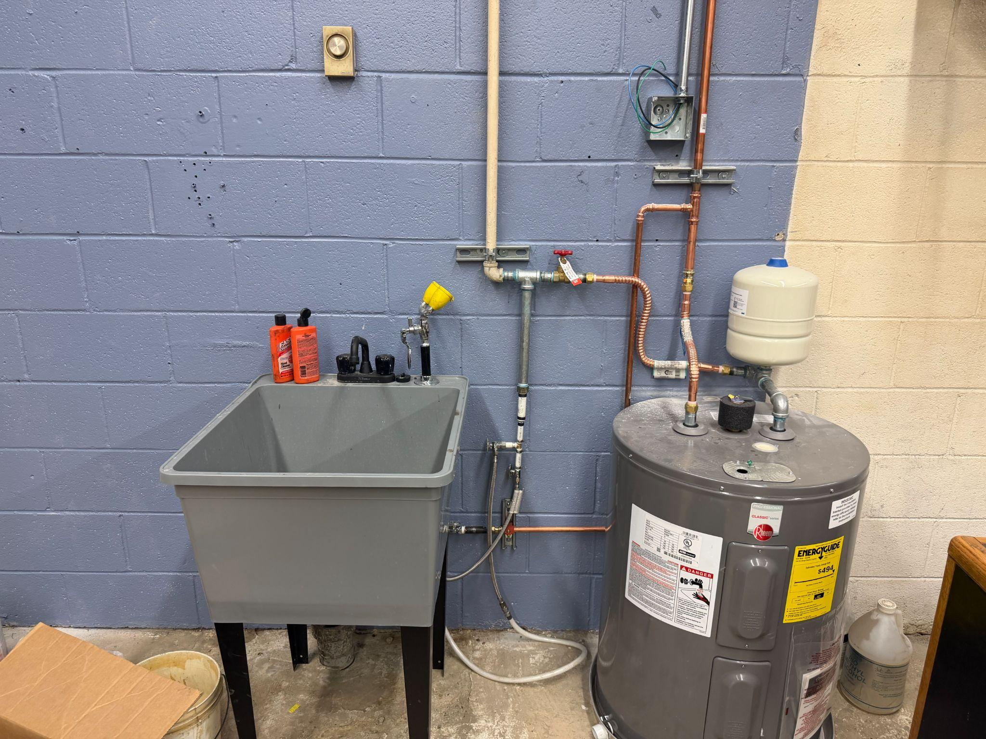
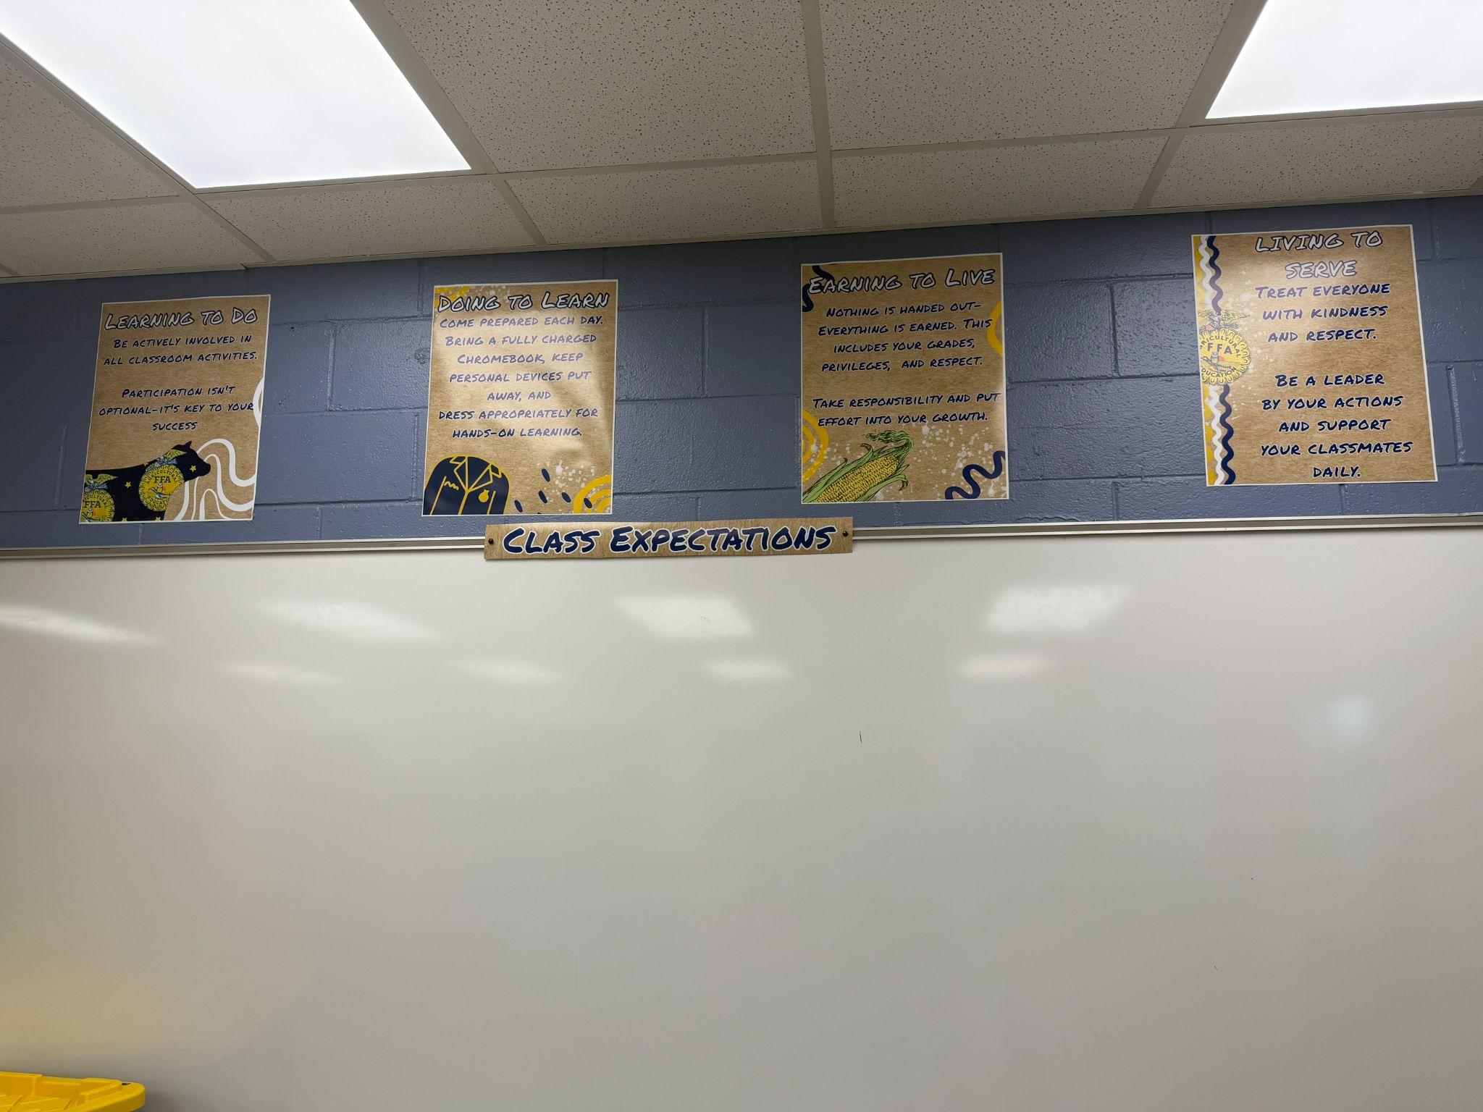
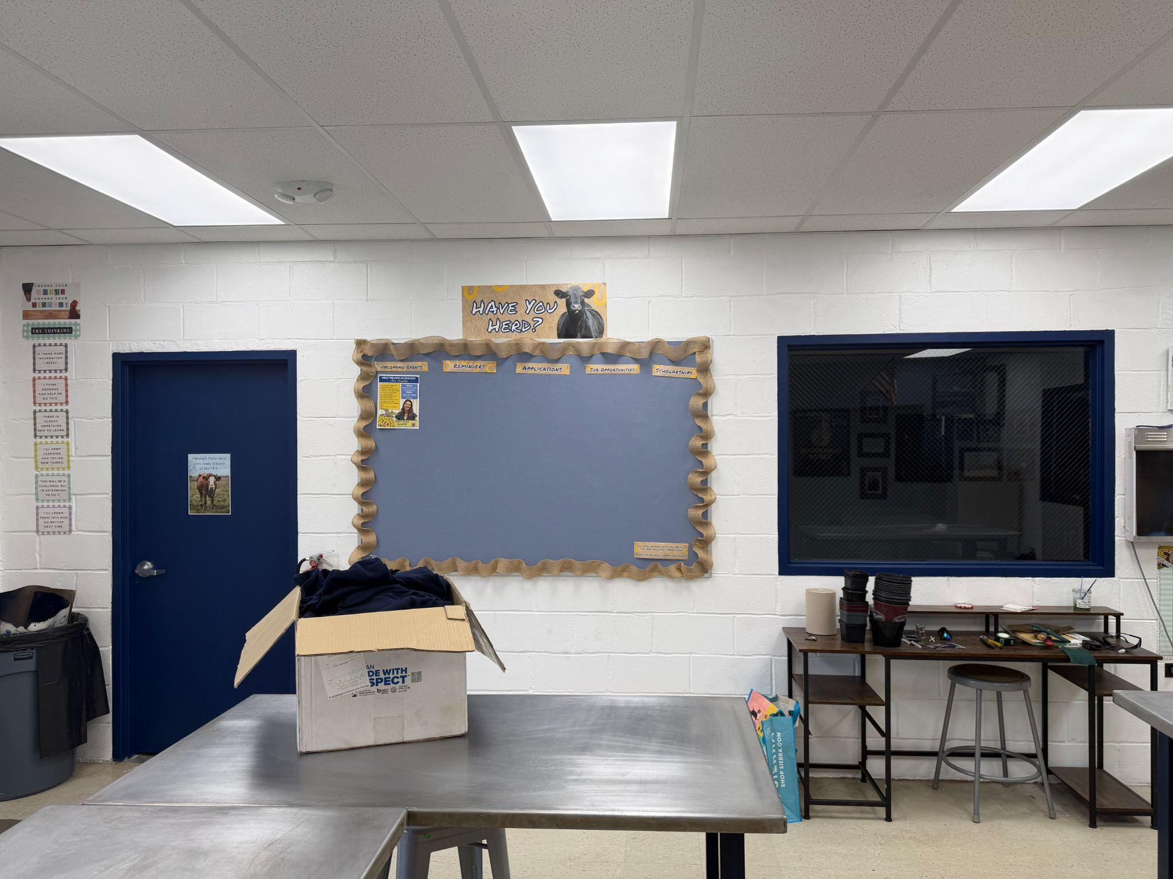
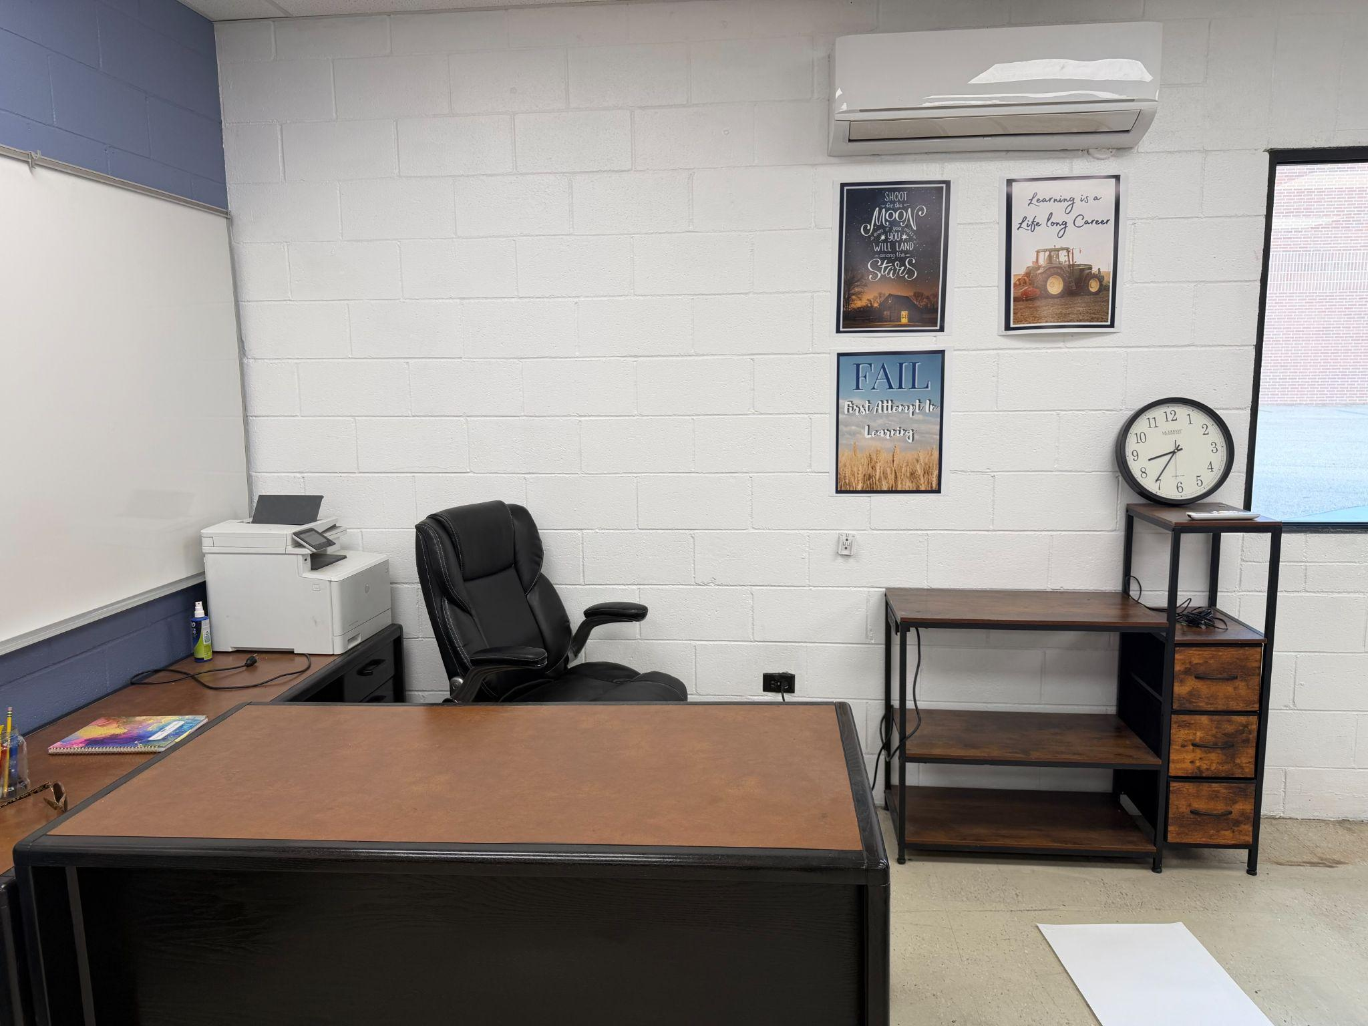
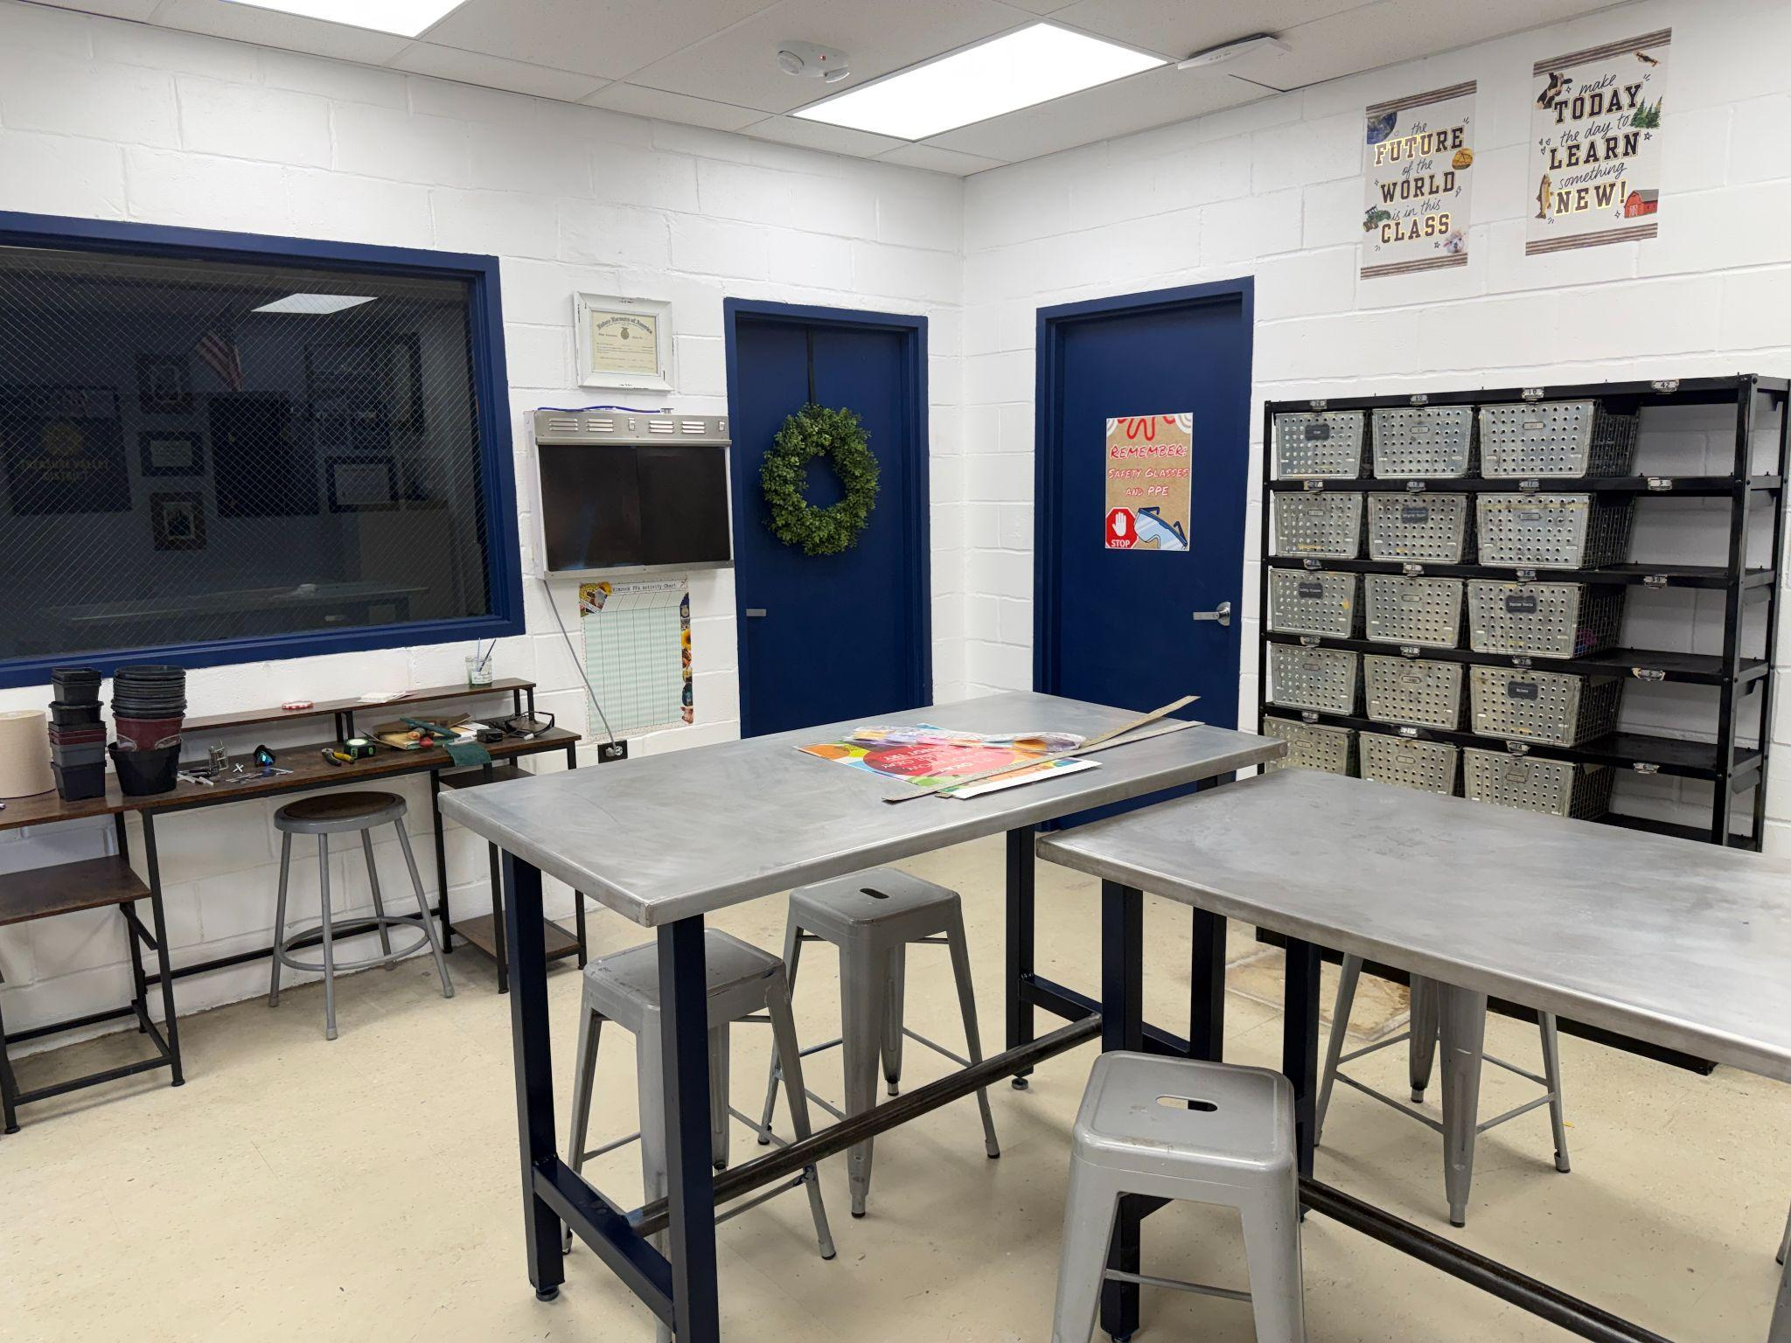
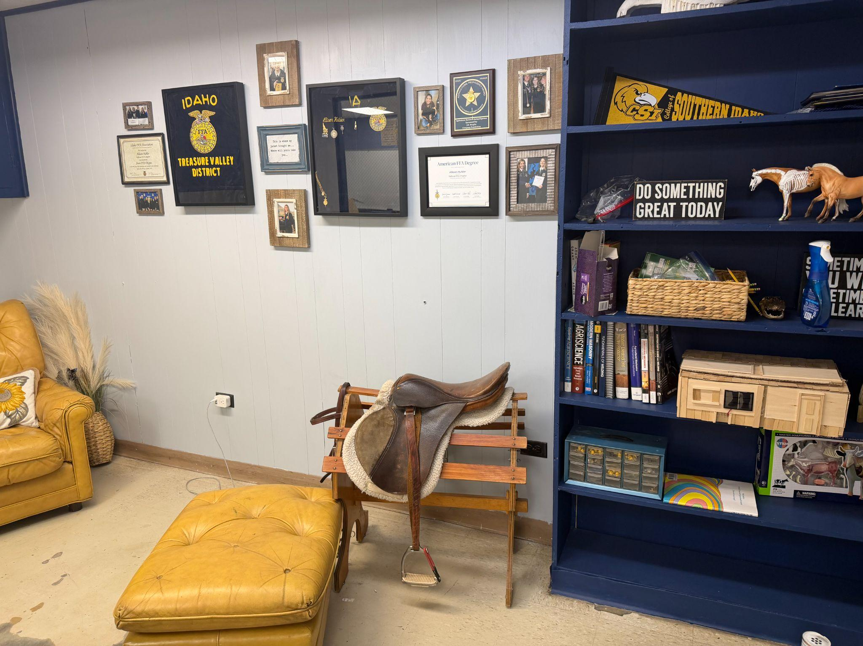
Allison Hampton’s Room (AG)

Slide 6

Allison Hampton

Slide 7
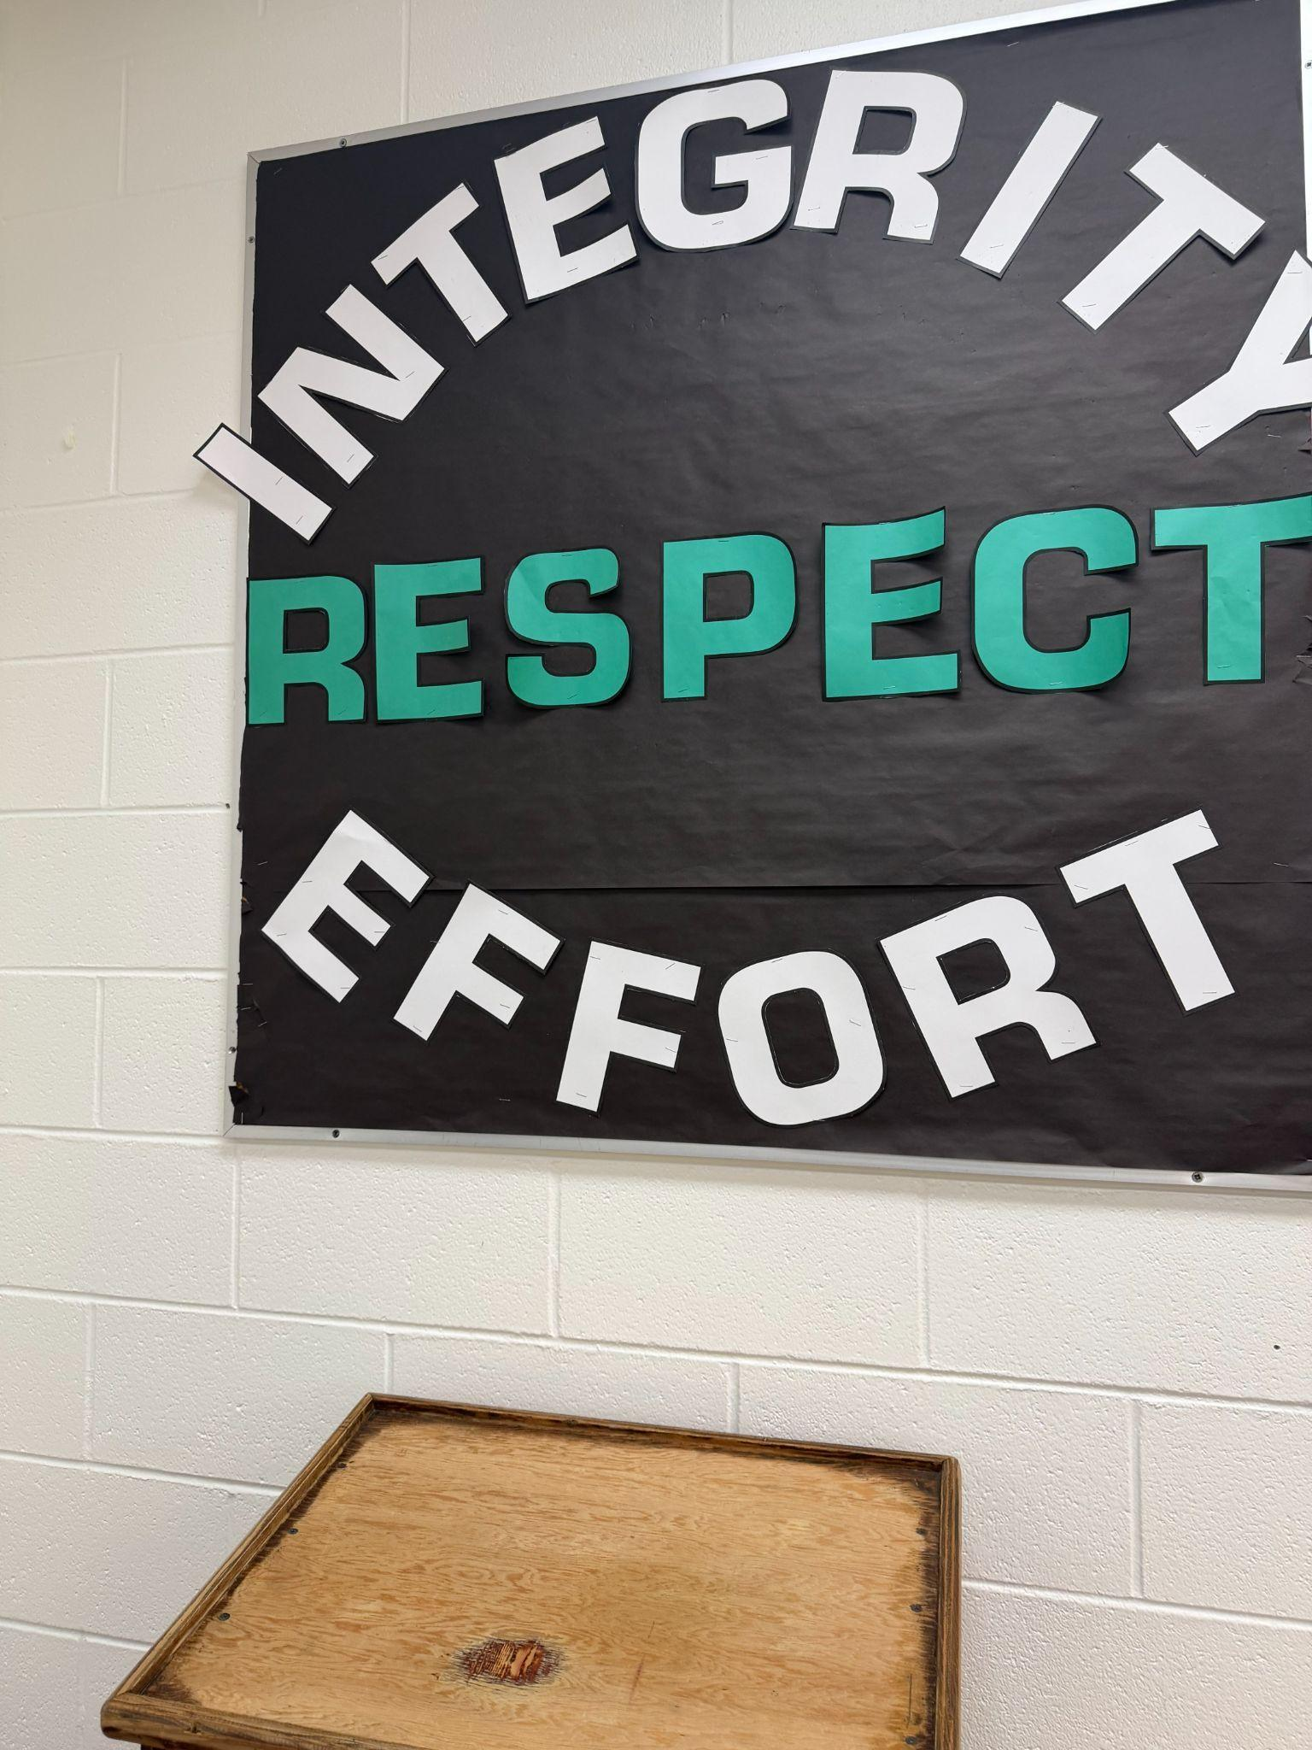
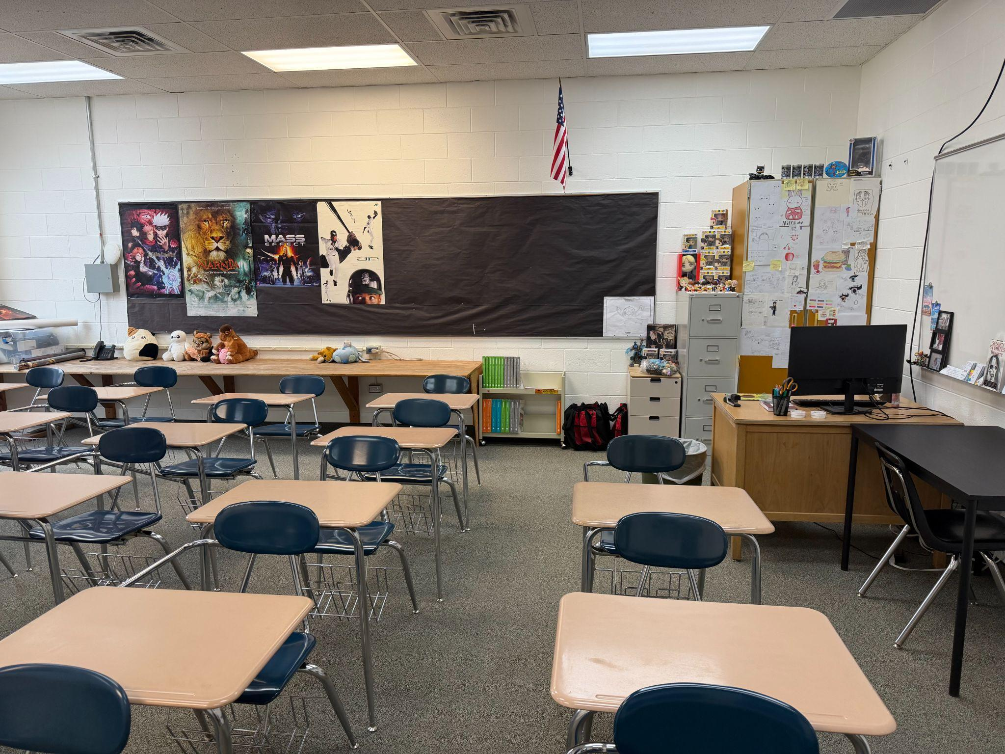
Dusti Scott’s Room (HS ELA)

Slide 8


Slide 9
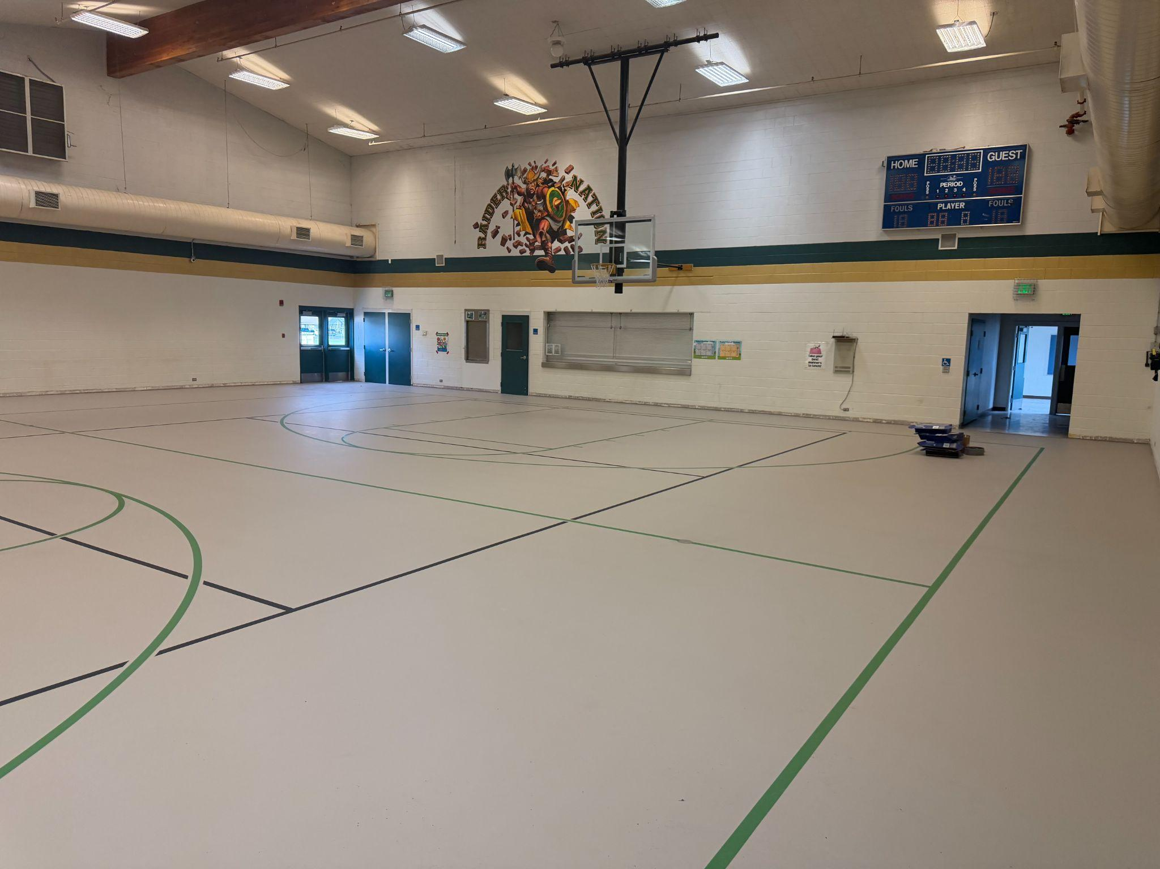
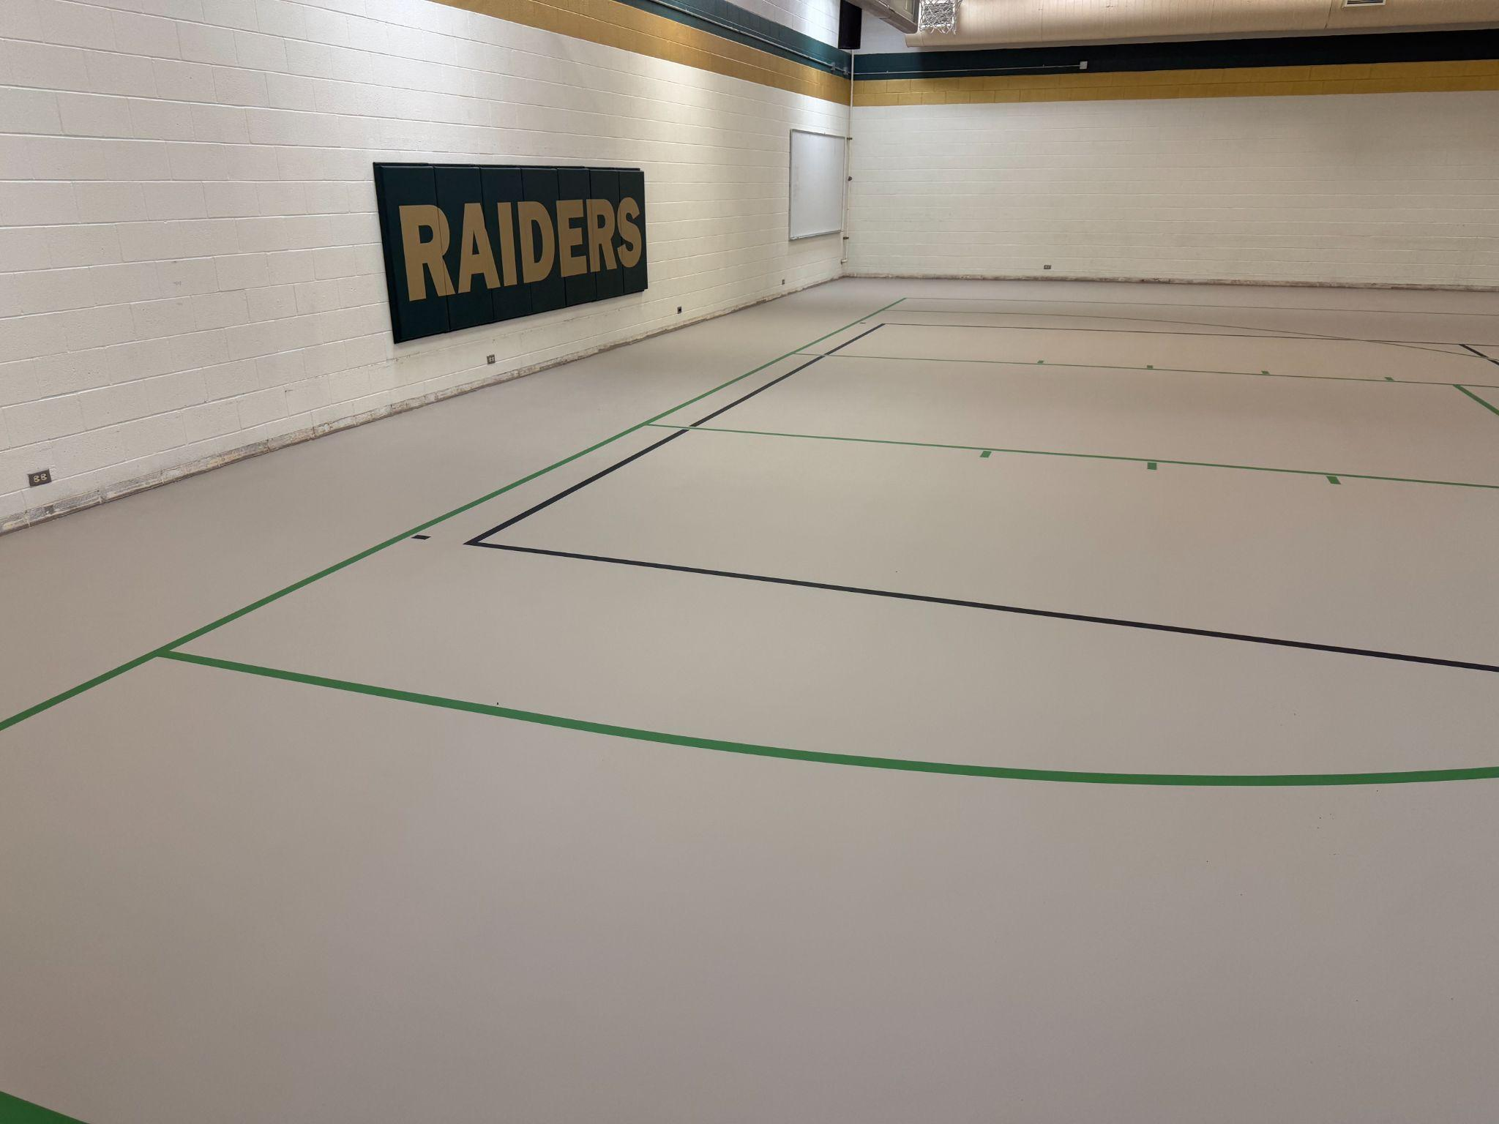
Superintendent Updates
Grand View Elementary School Floor Update
Grand View Elementary School Bleachers

Slide 10

Superintendent Updates
Rimrock Jr/ Sr High School Handbook

Slide 11
Superintendent Updates
Policy 8240 Discussion
Policy 8245 Discussion

Slide 12
Superintendent Updates
Soccer Co-Op with Mountain Home High School

Slide 13
Superintendent Updates
First Slide:
13 employees will need insurance again
3 employees did not use it last year, but may switch
3 employees will opt out
Second Slide: Alternative Plan Option A
5 Prefer Select Health Plan 17-18 HSA Silver
4 Prefer Select Health Plan 11-12 Silver 3000
3 Prefer Select Health Plan 7-8 Gold 500
Third Slide: Alternative Plan Option B
9 Not Prefer this plan
3 Prefer Regence Silver 3200
1 Prefer Regence Platinum 500
The Board will also consider establishing the District's monthly employer contribution toward employee health insurance premiums at $ per eligible employee per month for the 2026–2027 fiscal year.
The Board will also consider establishing the District's monthly employer contribution toward employee health insurance premiums at $ per eligible employee per month for the 2026–2027 fiscal year.
The Board will also consider establishing the District's monthly employer contribution toward employee health insurance premiums at $ per eligible employee per month for the 2026–2027 fiscal year.
The Board will also consider establishing the District's monthly employer contribution toward employee health insurance premiums at $ per eligible employee per month for the 2026–2027 fiscal year.
The School Board will determine the BGVSD#365 monthly employer contribution toward employee health insurance premiums for the 2026-2027 fiscal year.
BGVSD#365 Currently contributes

Slide 14
Superintendent Updates
Staffing Update:
Cook- We have a long term sub currently
Custodian- Grand View ES
Maintenance- Open
Paraprofessional-Open
Jr High Volleyball Coach- Open
Jr. High Football Coach- Open- If we have enough interest
High School Soccer- We will need to hire if we have 3+ students

Slide 15

OPEN THE PUBLIC HEARING

Slide 16
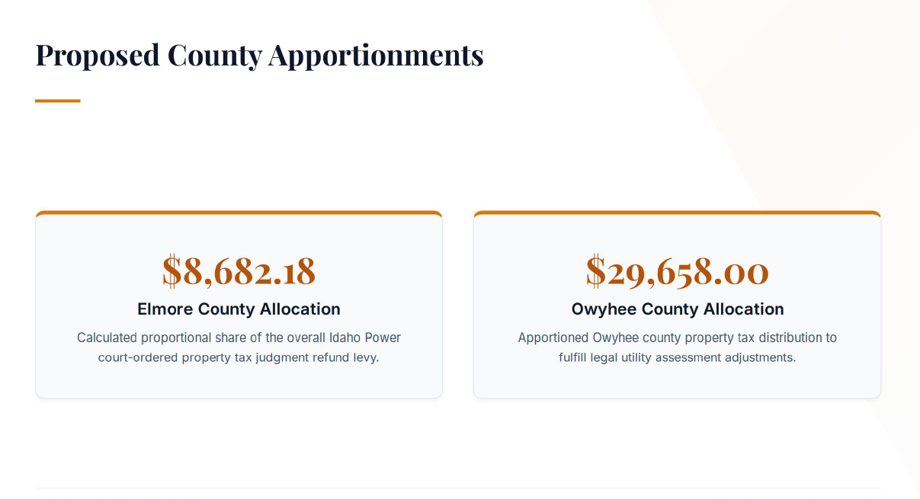

Slide 17
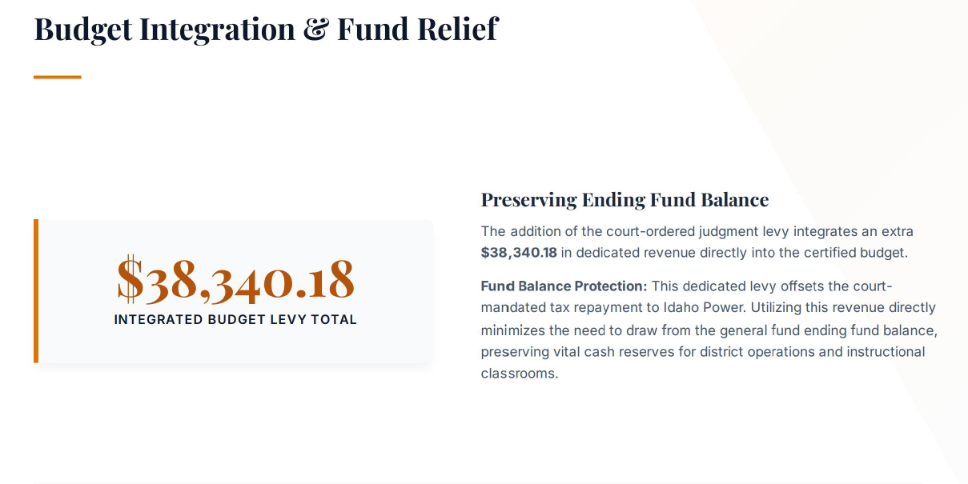

Slide 18
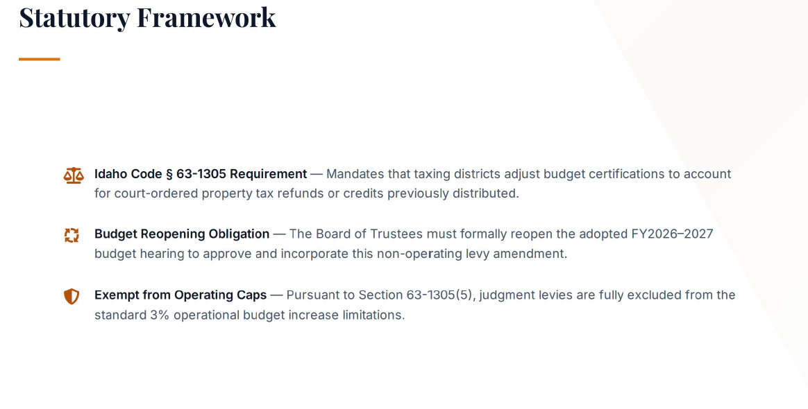

Slide 19
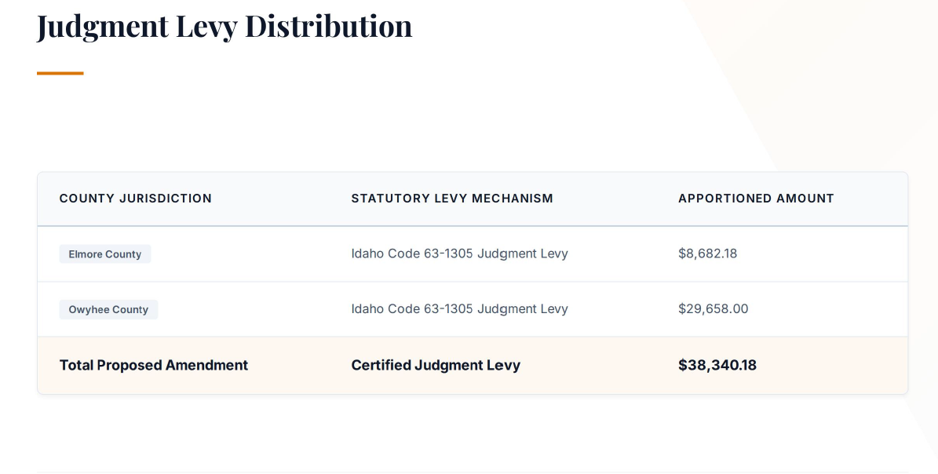

Slide 20
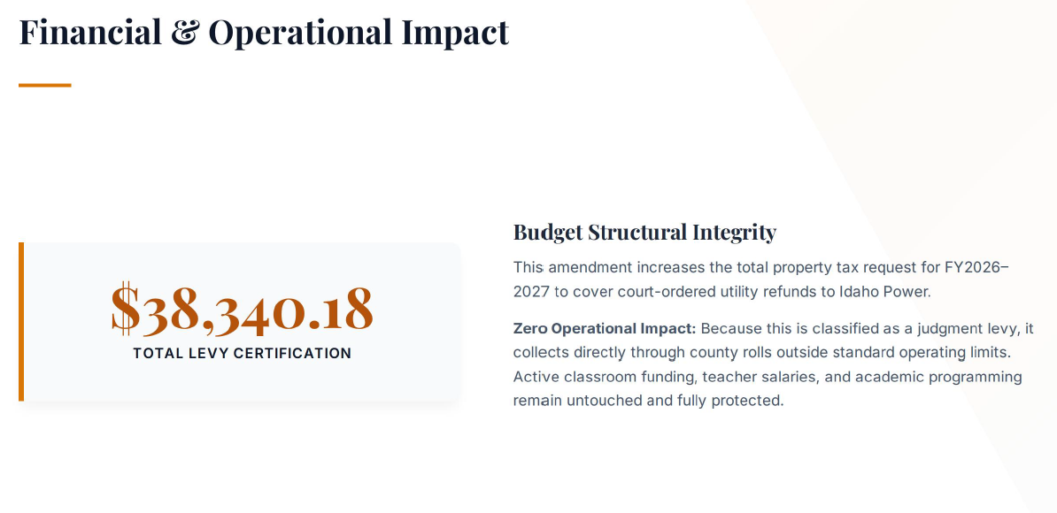

Slide 21
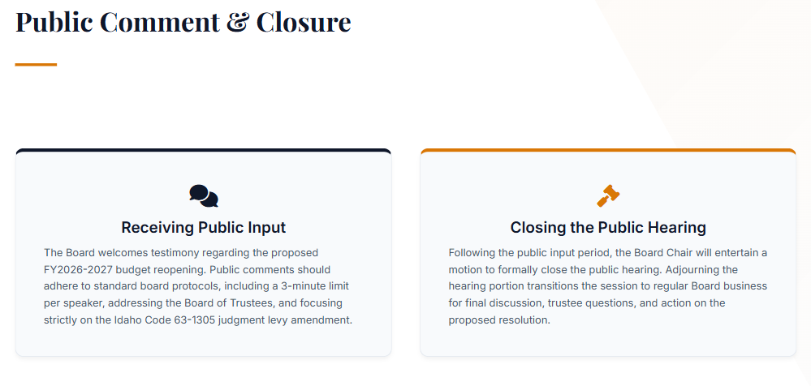

Slide 22
Executive Session

Slide 23
Action Items

Slide 24
Adjourn

