Slide 1
Budget Hearing
June 09, 2026

Slide 2
Agenda
Funding and Revenues
Expenditures
Fund Balance
Salary Based Apportionment
Discretionary Funds – Support Units
Federal Funds – Title $, SpEd $, etc.
Special Distribution Funds

Slide 3
BGVJSD Funds
Types of Funds
  The General Fund (100’s)
  Special Revenue Funds, Capital Projects Funds, Debt Service Funds, and Agency Funds (200’s – 700’s)
Other Common names– A federal fund, an ASB Fund (Associated Student Body), Facility Fund
Notes:
Types of funds
Special revenue funds – these hold specific funds or a specific purpose such as Safe and Drug Free, State Technology, even Title I, Title II, Title IV and IDEA
Capital Project Funds – Funds for facilities
Debt Service – Funds for paying down debt – sometimes districts will use this, sometimes it will be paid from the general fund – if the debt is based on tax revenues then it should be in a separate fund
Agency funds – that is when we hold funds for someone else – ASB
The General Fund – that is the fund that houses anything that is not in these other funds – General Fund is what we use for operations
Other common names
Capital Project Funds – Facility Funds
Federal Fund – Special Revenue Fund
ASB Fund – Agency Fund
Why do we separate them out
Track funding separately

Slide 4
Types of Fund Revenues
Local Funds
  Investment income
  Donations
  Rentals
  Levy
  Scholarship Fundraising
State Funds
  Discretionary (Units)
  Salary Based Apportionment
  Statutory (IT, Literacy, PD)
  Facility
Federal Funds
  IDEA (Special Education)
  Title
    I, II, III, IV
  USDA (School Nutrition)
Notes:
Types of revenues, discuss each one of these
Local Funds
What are these – explain them real quick
State Funds
Explain what state funds are – walk through each of them
Discretionary
Salary Based Apportionment
Statutory Funds
Facility Funds
Federal Funds
Explain what federal funds are – walk through each of them
IDEA Funds
Title Funds
USDA Funding

Slide 5
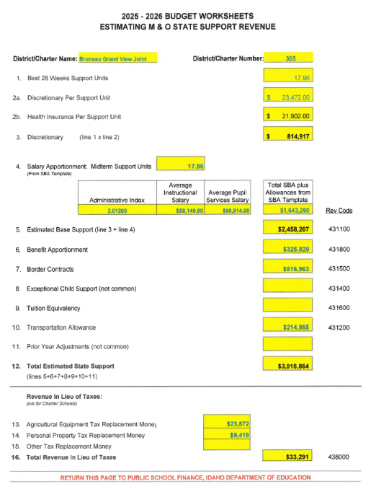
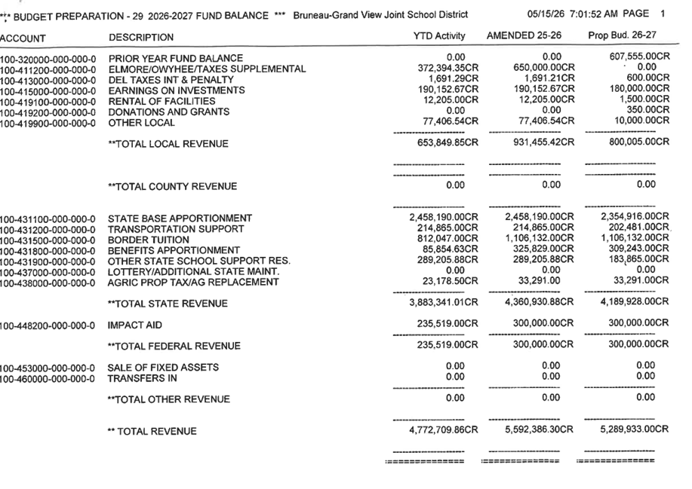
2026-2027 Proposed Revenues
Notes:
33-801 - The board of trustees of each school district shall also prepare and publish, as a part of such notice, a summary statement of the budget for the current and ensuing years. Such statement shall be prepared in a manner consistent with standard accounting practices and in such form as the state superintendent of public instruction shall prescribe, and, among other things, said statement shall show amounts budgeted for all major classifications of income and expenditures, with total amounts budgeted for salary and wage expenditures in each such classification shown separately. Such statement shall show amounts actually expended for the two (2) previous years for the same classification for purposes of comparison. The budgeted dollar amounts of revenue in those categories included within the provisions of section 33-802, Idaho Code, as approved

Slide 6
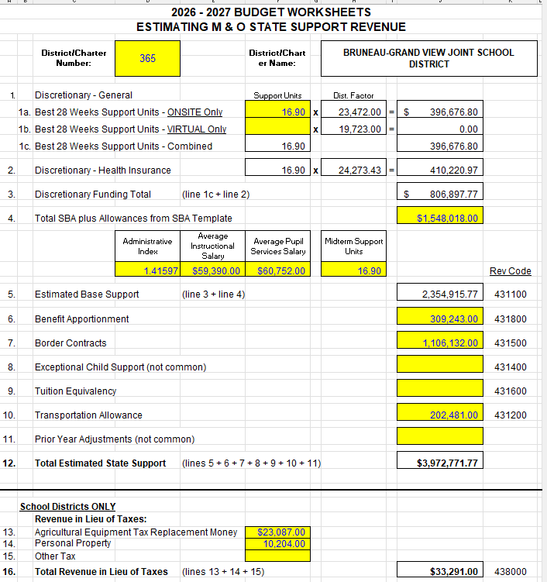
Considerations when planning for revenues?
Potential for loss of some students? (enrollment trends over time) approx. 15 students
And what could that impact be?
  Depending on how many students drop it could be approximately 1 support unit (We could lose support units if we lose attendance as well…)
  Refer to support unit calculation worksheet – if the percentage of ADA goes down… (p. 2)

Slide 7
Salary Based Apportionment (SBA)
Projected Revenue(to receive)
Support units projected: 16.9
FTE allowed:
  Administrative: 1.76
  Instructional: 18.25
  Pupil Services: 1.33
  Classified: 6.33750
Total SBA Projected to receive:
  Salaries: $1,548,018
  Discretionary: $396,676
  Benefits: $323,054(not health)
  Health-410,220.97
Actual Expenditures(what we are spending)
Support units earned: 16.9
Actual FTE:
  Administrative: 2 (.24 over)
  Instructional: 19.49 (1.24 over)
  Pupil Services: 1 (.33 for secretary)
  Classified: 20.5 (14.17 over)
Actual SBA costs of staffing:
  Salaries: $2,168,202 ($620,184)
  Discretionary: $2,675,248
  Benefits: $446,482.49 ($123,428.49)(not health)
  Health-900.00 per month x 27 empl.$291,600
*73% is salaries/benefits of total GF budget

Slide 8
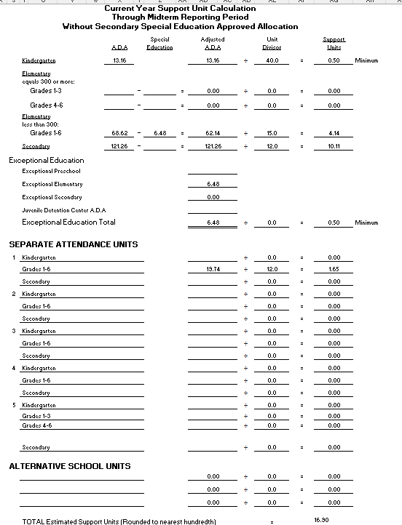

Slide 9
How many in each grade make a support unit?
K - 40 students
1-3 – 16 students
4-6 – 16 students
7-12 – 12 students
Alternative 14.5
Special Education 14.5 students (based on the 6% (elementary) and 5.5% (secondary) calculation)
**Based on ADA – not enrollment

Slide 10
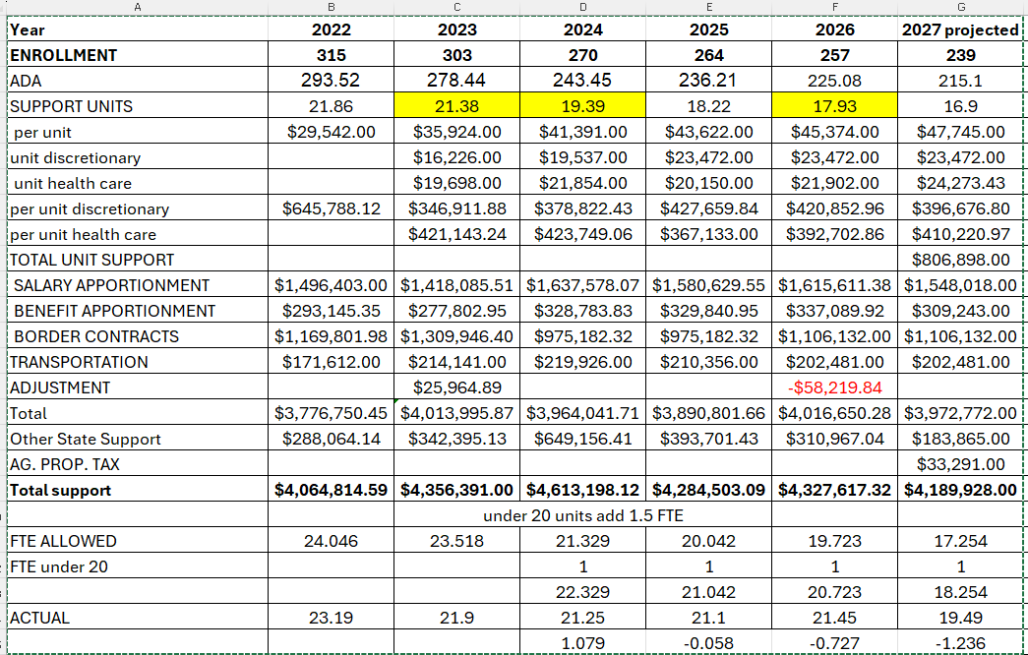
Foundation payments 5 year
*protected

Slide 11
Types of Expenses
Salaries
  Salaries – teachers, admin, classified
  Stipends
  Class Coverage (subs)
Benefits
  Insurance (medical, dental, vision)
  Taxes (FICA & Medicare)
  Workers Compensation
Non-personnel costs
  Purchased Services
    Contracts, Other Services
  Supplies
  Debt Service
  Capital Expenses
    Construction
    Equipment
Notes:
Explain each of these types of expenses are important – talk through some of the drivers of them

Slide 12
Two Parts of the State Funding Formula
(Note: State funded portion of our General Fund)
Salary Based Apportionment (SBA) includes salaries and benefits:
  Salaries: State provides to the District to pay for salaries:
    Administration: Superintendent and Building Principals
    Pupil Services: Counselors, Psychologists, Speech Therapists, etc.
    Instructional (Certificated): Teachers and other credentialed staff
    Classified (Non-certificated): Business Manager, Food Service manager, Paraprofessionals, Administrative assistants, Custodians, Bus drivers and all other support staff.
  Benefits: For all salaries above, the state provides 20.13% to cover FICA, Medicare and PERSI employer contributions. It is important to know that the state does not cover any healthcare or other benefit costs through this part of the formula - (General Fund $)
Discretionary Dollars: General Fund monies used for academic programs and general operating expenses.

Slide 13
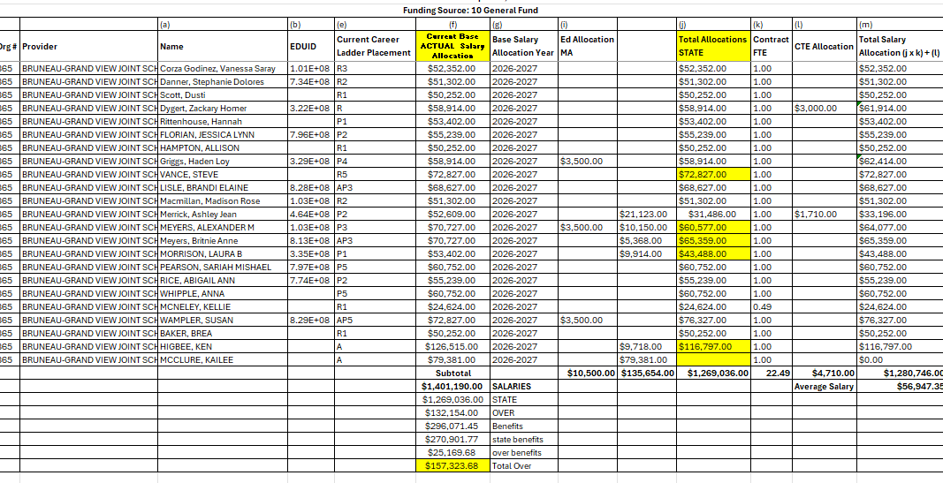
Certified Salaries

Slide 14
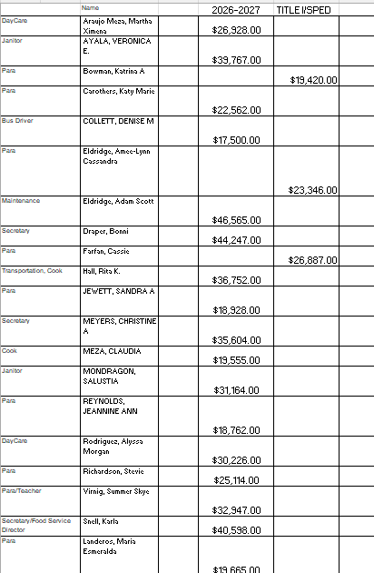
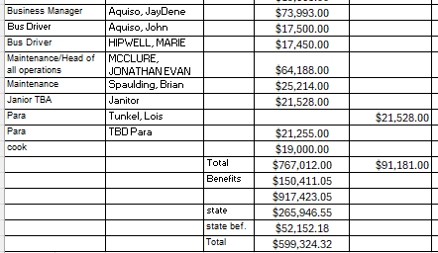
Classified Salaries/Benefits

Slide 15
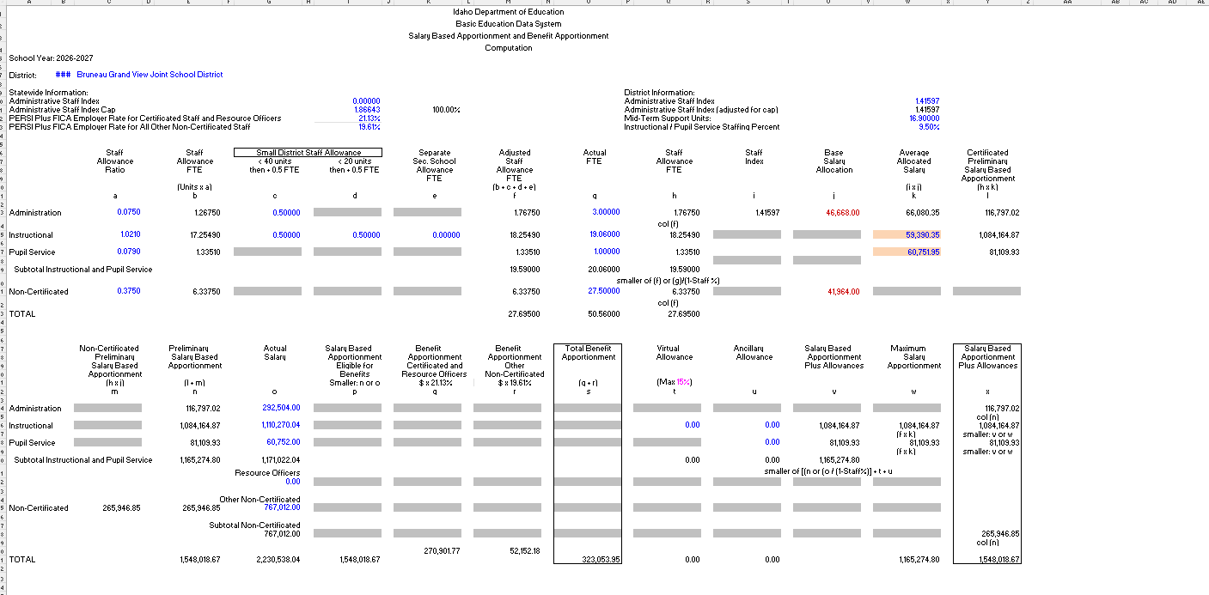
Salary Based Apportionment Worksheet

Slide 16
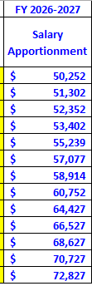
Salary Schedule
Our salary schedule in alignment with the State career ladder (IC 33-1004B)
  The State gave only the cell increase if a teacher moved

Slide 17
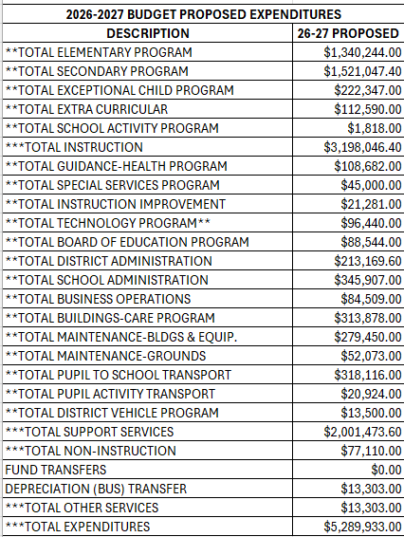
2026-2027 Budget Proposed Expenditures (General Fund – 100’s)

Slide 18
Discretionary Dollars
Projected
(off projected Student enrollment #s)
Support units: 16.90
1 support unit = $47,745
Health Discretionary-$24,273
Discretionary-$23,472
Possibility of units dropping 15-20 students Secondary Grade Configuration
Minimum Support Units -Grades 7–12-8 units (we are allowed 10.11 currently)
Total projected to receive:
  $806,898
Actual
Not calculated until the end of the year
Current ADA by building:
  Elementary: 92%
  Secondary: 92%
District wide ADA = 92%
Anticipating Best 28 Week units to come in around 16.9 (First day of school to June 15)
Total projected to receive:
  $806,898

Slide 19
Fund Balance
Current Fund Balance is approximately $4.3 Million
Notes:
7215 - Fund Balance Reporting in Governmental Funds
The following definitions will be used in reporting activity in governmental funds across the District. The District may or may not report all fund types in any given reporting period, based on actual circumstances and activity.
Non-spendable Fund Balance: Includes amounts that cannot be spent because they are either:
Not in spendable form; or
Legally or contractually required to be maintained intact.
Restricted Fund Balance: Includes amounts that can be spent only for the specific purposes stipulated by District policy, external resource providers, or through federal regulations or State laws or rules.
Committed Fund Balance: Includes amounts that can be used only for the specific purposes determined by a formal action of the Board.
Assigned Fund Balance: Includes amounts intended to be used by the District for specific purposes, but do not meet the criteria to be classified as restricted or committed. In funds other than the general fund, the assigned fund balance represents the remaining amount that is not restricted or committed.
Authority to Assign - The Board delegates to the Superintendent or designee the authority to assign amounts to be used for specific purposes. Such assignments cannot exceed the available (spendable, unrestricted, uncommitted) fund balance in any particular fund.
Unassigned Fund Balance: Includes the residual classification for the District’s general fund and includes all spendable amounts not contained in the other classifications. In other funds, the unassigned classification should be used only to report a deficit balance from overspending for specific purposes for which amounts had been restricted, committed, or assigned.

Slide 20
Fund Balance
Other Funds – Solar, Impact Aid

Slide 21
Fund Balance – What it can be used for…
Manage cash flow
Plan for future expenditures*
Changes in enrollment
Facility Planning and remodel*
Bond rating impacts*
*Dating back to 2020, a ten-member Ad Hoc Committee set 3-goals:
1. Develop a strategic three-year plan;
2. Allocate funds for future infrastructure needs; and
3. Recommend a long-term facilities model (due in 2024).
* 2024 Ad Hoc Committee recommended exploring the possibility of a
K-12 campus at Rimrock
Where would you like to set the fund balance to be?

Slide 22
What is Title Funding and How is it calculated
Title Funding is a federal funding program designed to supplement school programs
  Title 1 -251, Title 1-C -253, Title IV 261, Title V-B 262, Title II-A 271,
Calculated based on poverty levels, student counts, and data largely from FRL (Free and Reduced lunch) calculations

Slide 23
Special Education Funding
General Fund Special Education Funding (100-616)
  5.5% of secondary and 6% of Elementary identified as special education, and then the ADA uses a divisor of 14.5
  Support Unit’s for Special Education - 1.0
  Maintenance Of Effort (MOE) $285,024
  Special education percentage for peers:
    Bruneau Grand View – 21%
    Basin – 27%
    Horseshoe Bend - 24%
    Mountain Home – 15%
IDEA Funding – Based on child find count or number of students that qualify (IDEA-B 257, PreSchool 258, Medicaid 260)
  Supplement school district special education operations
MOE - Schools must maintain or increase its own financial contribution for special education programs and services for students with disabilities (supplemental)

Slide 24
Special Distribution Funds (Specific Use Only)
Advanced Opportunities - $4,625-flow through
College and Career Advisor - $17,460
Continuous Plans and Training - $6,600
Digital Content and Curriculum – 0
English Language Learners - $340
Literacy Intervention - $27,470
Math and Science (99 students or less) - $62,700
Professional Development - $17,212
PD Dyslexia - $4,069
Remediation - $37,335
Ag and Personal Property Tax - $33,291
Safe and Drug Free Schools - $4,850 (246-000)
Technology in the Classroom - $29,865 (245-000)
School District Facilities Fund - $42,765
School Modernization Facilities Fund - 0

Slide 25
FY 2026-2027 Budget Overview
Adjusted Budget (Border Contract Removed)
Total Expenditures: $4,183,801
Salaries & Benefits
$3,137,850
75% of Total Budget
Teachers
Classified Staff
Administrators
Employee Benefits
Administration
17.5%
Superintendent
Head of Operations
Business Manager/Clerk
Board of Trustees
School Administration
Transportation
7.3%
Bus Drivers
Fuel
Vehicle Maintenance
Student Transportation
Technology
2.3%
Software Licenses
Technology Equipment
Network Services
Instruction
51.0%
Classroom Instruction
Curriculum
Special Education
Extracurricular Programs
Facilities & Grounds
15.4%
Utilities
Custodial Services
Maintenance & Repairs
Grounds Upkeep
Student Support
4.2%
Counseling Services
Special Services
Professional Development
Food Service Transfers
1.8%
Support for Child Nutrition Programs
Notes:
Talk through these expenses
how these drive expenses
Knowing about these helps you manage expenses – ask questions about these things as a board members or be knowledgeable about these things?
Talk about these line items – each of them – so you know how they impact the financial statements
Know the drivers of those expenses
Admin salary agreements – what drives them

